Slide 1
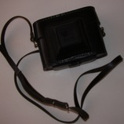
Smena 8

Slide 2
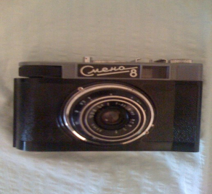
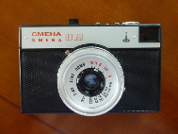
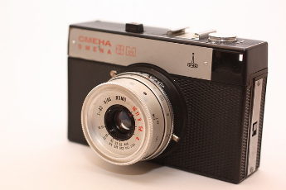
Smena 8 camera
Smena is a series of low-cost 35 mm film cameras manufactured in the Soviet Union by the LOMO factory from 1953 to 1991
Smena 8m

Slide 3
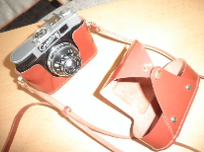
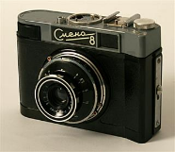
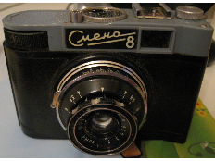
Smena 8m
Lens: Triplet 43, 40 mm, f/4, 3 elements
Focal range: 1 m to infinity, scale-focus
Shutter speeds : B, 1/15, 1/30, 1/60, 1/125, 1/250
Shutter type: 3 blades diaphragm shutter
Apertures: f/4, f/5.6, f/8, f/11, f/16
Film type: 35 mm film
Size: 70 x 100 x 60 mm
Weight: 289 g

Slide 4
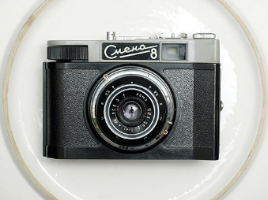
Smena 8m
Made by GOMZ, LOOMP and LOMO
Produced between 1963-71
From: SSSR
Smena-8 was the camera USSR tried to enter the international market.

Slide 5
Smena 8

Slide 6
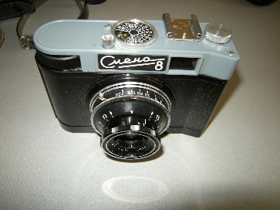
eTwinning project: On the Track of Our Recent Past
II. osnovna škola Čakovec, Croatia
Teacher: Iva Naranđa
Made by: Nikša Jelenić 7.b
Camera Week, April, 2016
Sources:
https://en.wikipedia.org/wiki/Smena_%28camera%29
http://camerapedia.wikia.com/wiki/Smena-8

