Slide 2
Box Camera

Slide 3
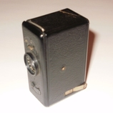
Box cameras rely on the most basic form of photographic technology, utilizing a sealed rectangular container with a fixed focus lens on one end and film at the other.
Early designs from the middel 1800s generally lacked any control over focus, aperture, or shutter speed.

Slide 4
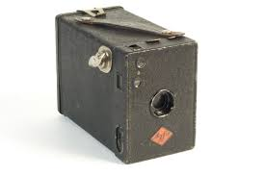
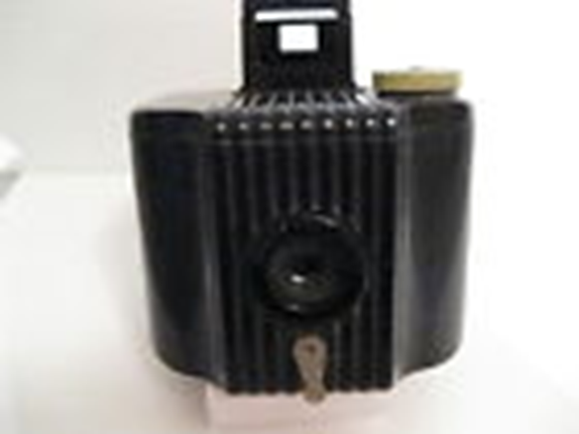
Box cameras frames were typically made of wood or metal, but later included detailed leather finishing or shiny Bakelite plastic.

Slide 5
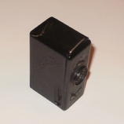
Limitations of the box camera design made them best for daylight photography with subjects at an intermediate distance from the photographer. Yet because of their simplicity, box cameras introduced millions of amateurs to photography, and created the concept of the snapshot as we know it today.

Slide 6
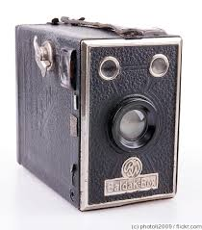
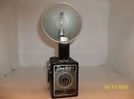
Kodak developed the first roll-format film during the 1880s, which made the box camera much easier to use and came to dominate all subsequent camera designs.

Slide 7
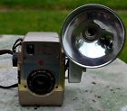
In 1892, S.W. Turner created the Bull’s Eye Camera, which featured film backed in black paper for loading in full daylight, along with a new exposure number that was visible to the user. Three years later, George Eastman bought Turner’s patent and continued to produce a version of this design as Kodak’s first Pocket Camera.
Bull’s Eye Camera

Slide 8
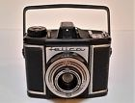
The Pocket Camera eventually relocated the interior film spools just beyond the lens mechanism, greatly decreasing the overall size. Kodak later made the camera even more compact...

Slide 9
Source:
http://www.collectorsweekly.com/cameras/box-cameras

Slide 10
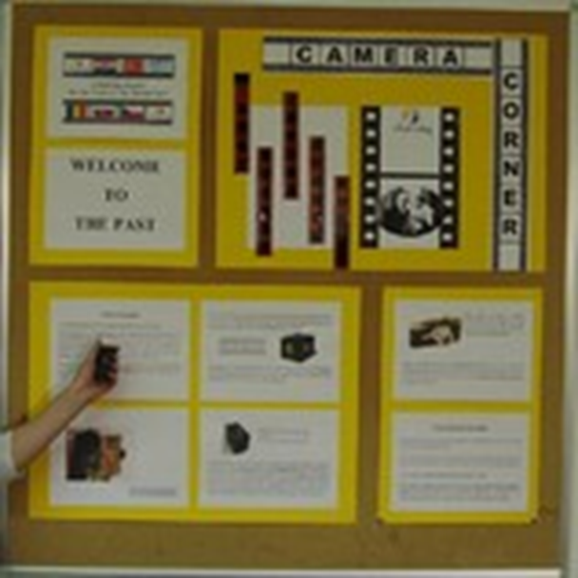
Made by: Lana Maček
School: ll. osnovna škola Čakovec
Teacher: Iva Naranđa
Camera Week, April 2016
Croatia
eTwinning project: On the Track of Our Recent Past

Slide 11
Thank you for your attention
Lana Maček

