Slide 1
Dishwashers and washing machines

Slide 2
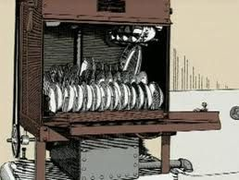
First dishwasher 1850s
The first reports of a mechanical dishwashing device are of an 1850 patent in the United States by Joel Houghton for a hand-powered wood device.

Slide 3
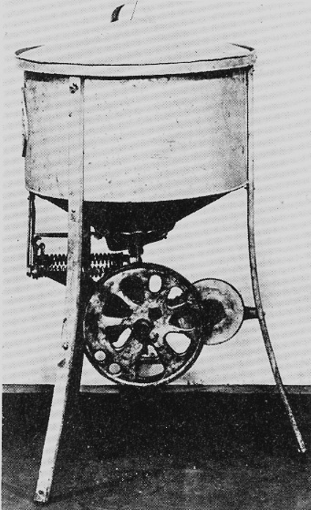
The Walker brothers
The Walker brothers of Syracuse, NY who owned a hardware store applied for and received a patent for a new dishwashing machine.
The 1911 model included a pulley and a belt so the machine could be operated "automatically" by means of a gasoline engine. Of course like the earlier dishwashers the machine still need to filled with water and emptied by hand.

Slide 4
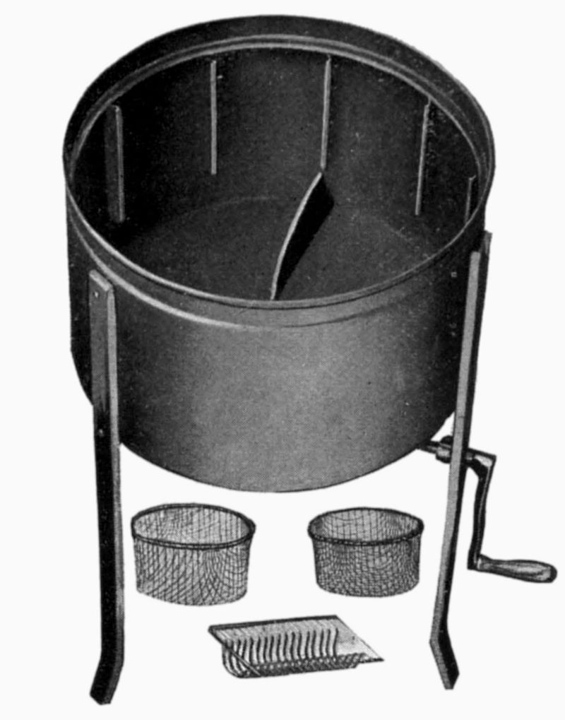
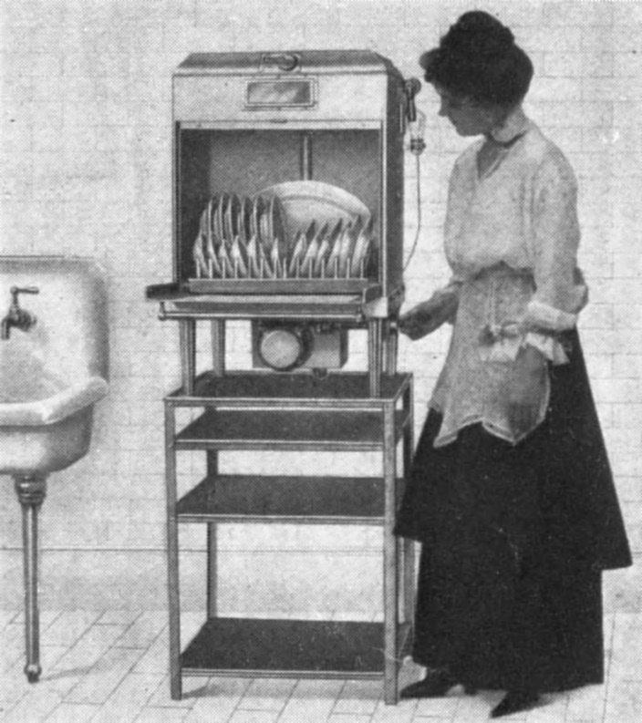
Dishwasher 1910s
A hand-powered dishwasher and an early electric dishwasher both from about 1917.

Slide 5
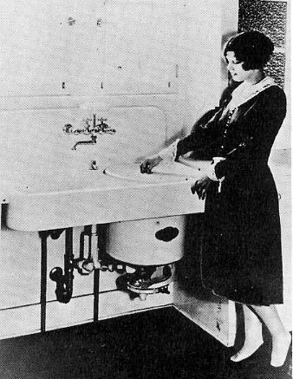
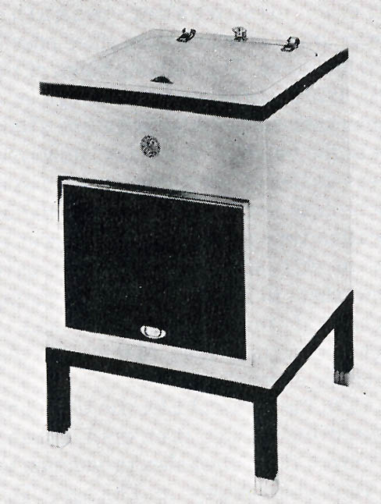
The first General Electric dishwasher
In 1930 GE had acquired the Walker Brothers Company and moved the dishwasher production to the Hotpoint factory in Chicago. The first General Electric branded dishwasher was produced in 1932.
1920s dishwasher
1930s dishwasher

Slide 6
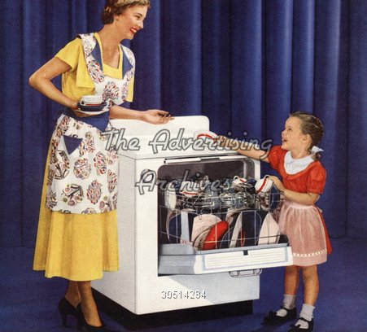
Dishwasher 1940s

Slide 7
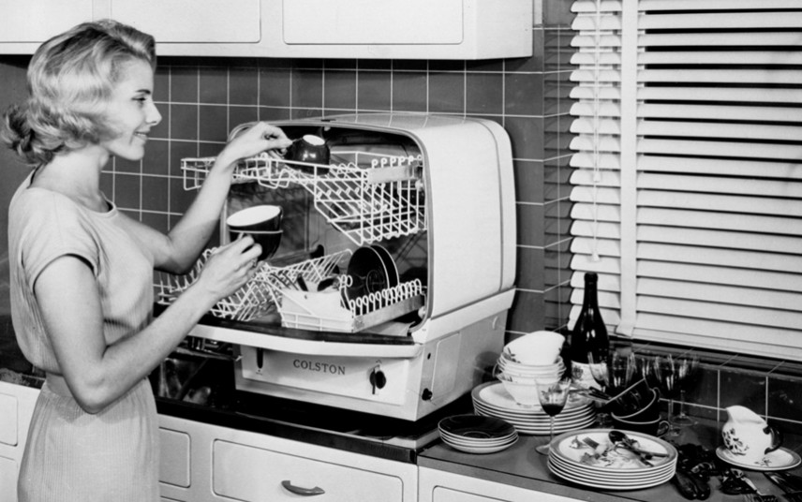
Dishwasher 1950s
This dishwasher is made by Charles Colston.

Slide 8
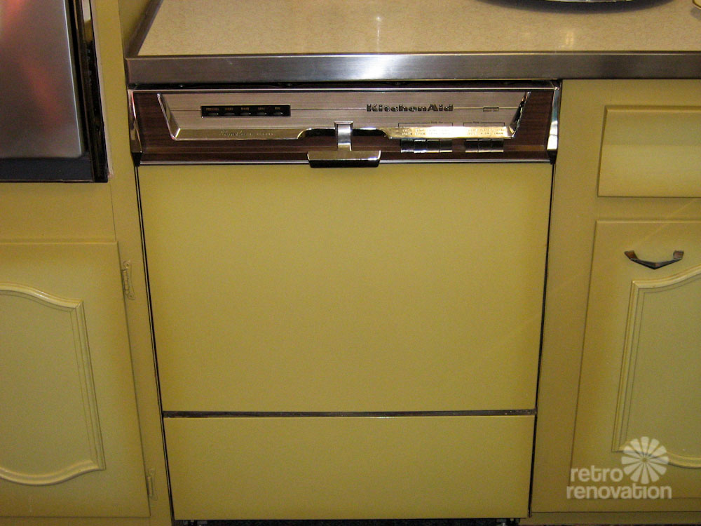
Dishwasher 1960s

Slide 9
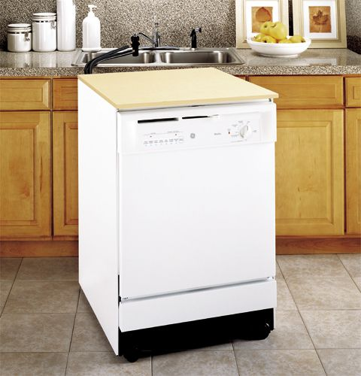
Dishwasher 1970s and 1980s

Slide 10
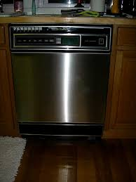
Dishmachine 1990s

Slide 11
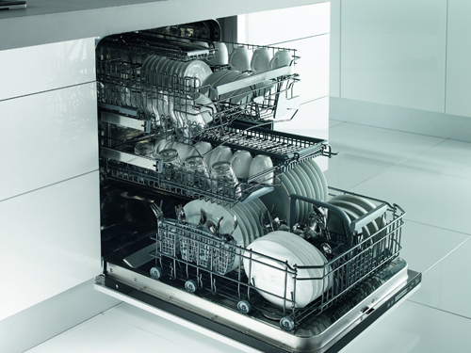
Dishwasher today

Slide 12
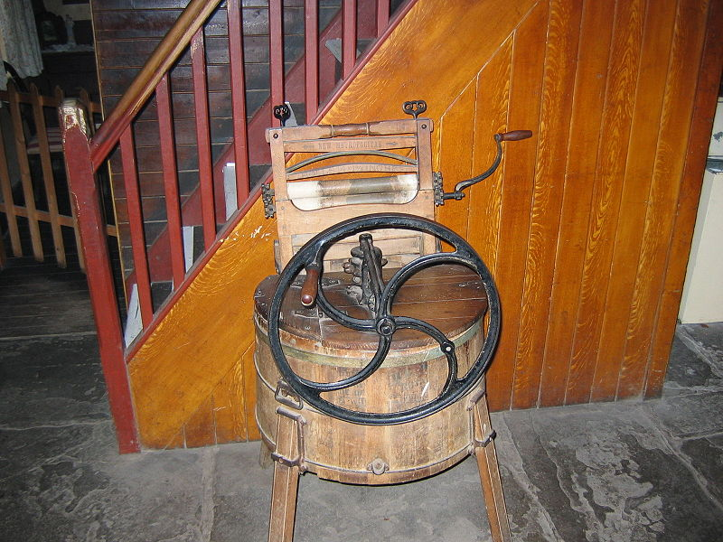
Washing machine
The first English patent under the category of Washing and Wringing Machines was issued in 1791.
This washing machine is from 19th century.

Slide 13
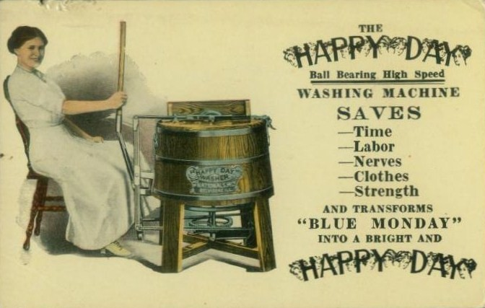
Washing machine 1910s

Slide 14
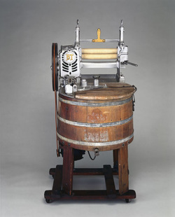
Washing machine 1920s

Slide 15
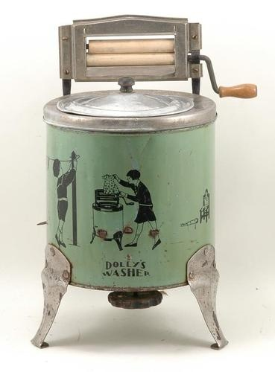
Washing machine 1930s

Slide 16
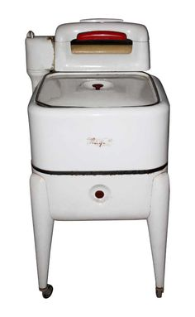
Washing machine 1940s

Slide 17
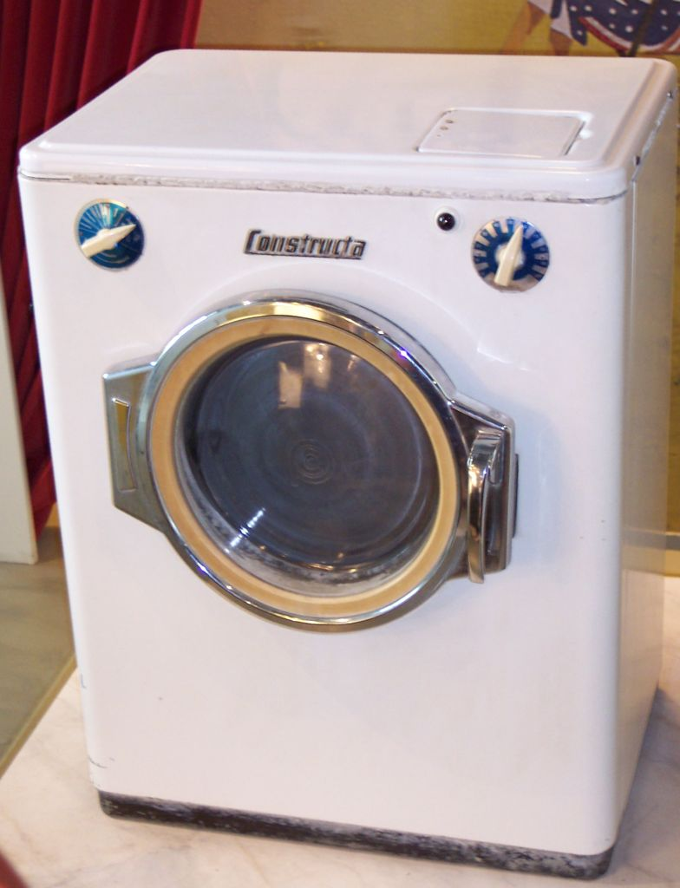
Washing machine 1950s

Slide 18
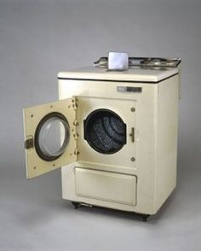
Washing machine 1960s

Slide 19
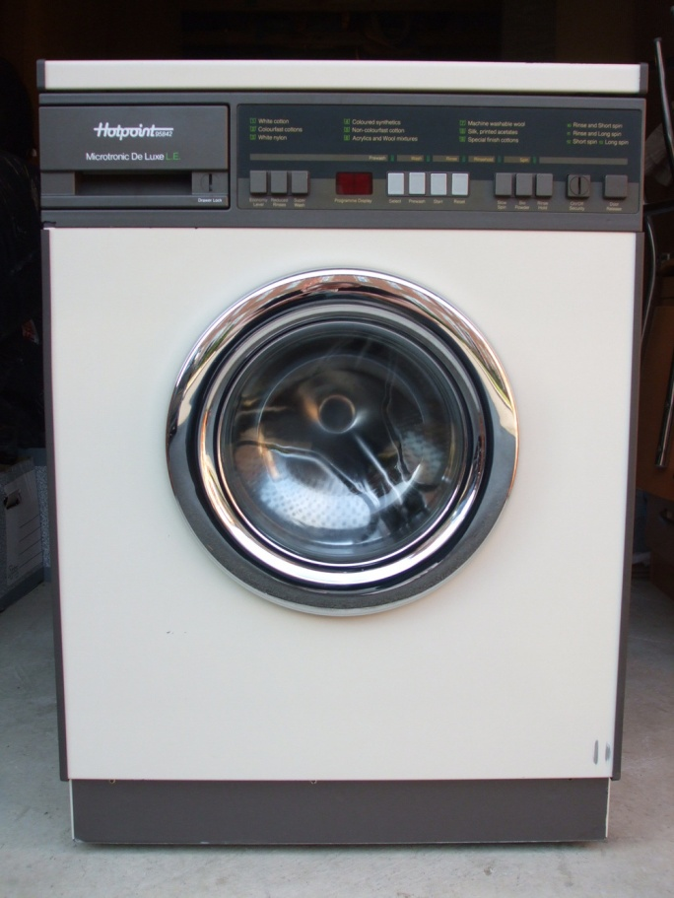
Washing machine 1980s

Slide 20
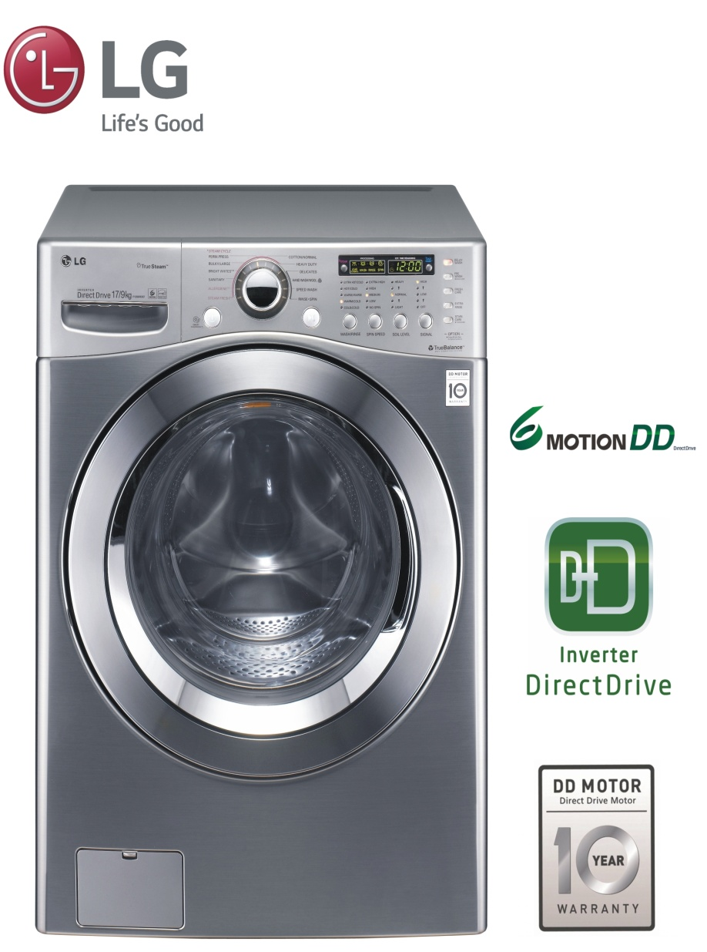
Washing machine today

Slide 21
Elena Jankaš, 6.a
Teacher: Iva Naranđa
II. osnovna škola Čakovec, Croatia
eTwinning project “On the Track of Our Recent Past”
May 2016
Sources:
https://en.wikipedia.org/wiki/Dishwasher
https://en.wikipedia.org/wiki/Washing_machine

