Slide 1
The first laptops
ETWINNING PROJECT
On the Track of Our Recent Past

Slide 2
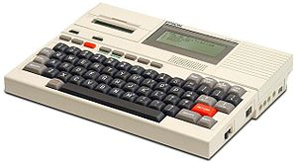
The first laptop
The Epson HX-20 (also known as the HC-20) is generally regarded as the first laptop computer, announced in November 1981, although first sold widely in 1983.
https://en.wikipedia.org/wiki/Epson_HX-20

Slide 3
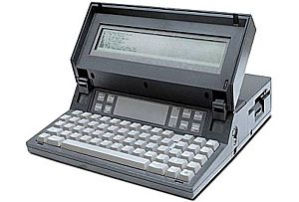
The Gavilan SC
The Gavilan SC was an early laptop computer, and was the first ever to be marketed as a "laptop".
https://en.wikipedia.org/wiki/Gavilan_SC

Slide 4
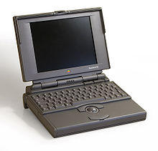
Some laptops from the 90s Powerbook
The Apple PowerBook series, introduced in October 1991, pioneered changes that are now de facto standards on laptops, such as room for a palm rest, and the inclusion of a pointing device (a trackball).
https://en.wikipedia.org/wiki/PowerBook

Slide 5
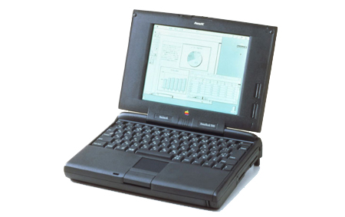
PowerBook 5300
The PowerBook 5300, while highly anticipated as one of the first PowerPC-based PowerBooks (along with the PowerBook Duo 2300c, both released on the same day), had numerous problems.
https://en.wikipedia.org/wiki/PowerBook

Slide 6
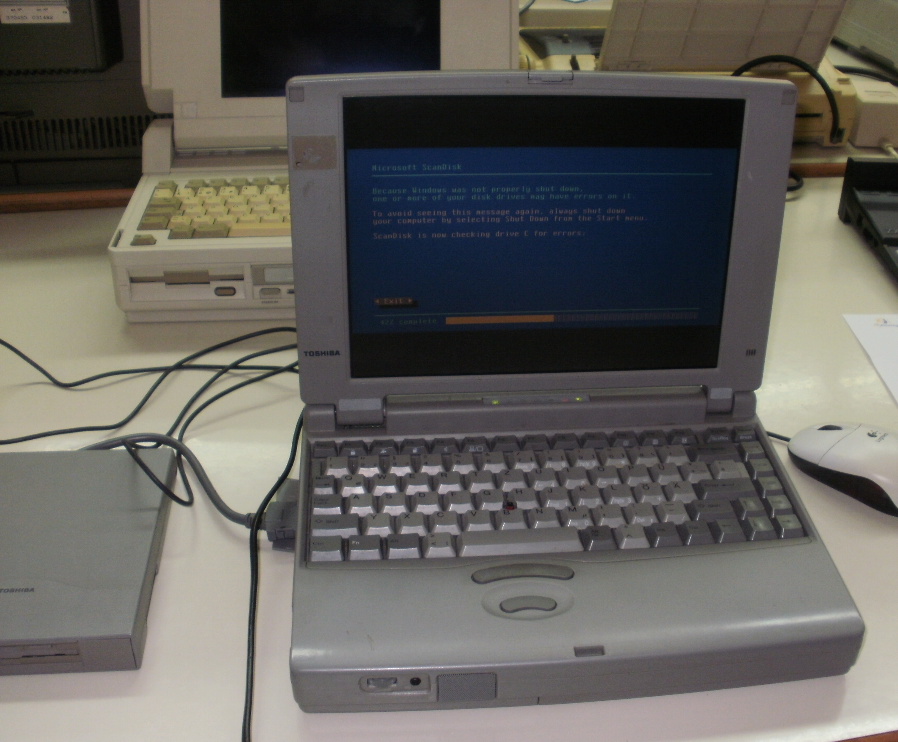
Here are two laptops we saw on the exhibition at our school:
The Toshiba Satellite (dynabook Satellite in Japan) is a line of consumer-grade notebook computers marketed by Toshiba.
https://en.wikipedia.org/wiki/Toshiba_Satellite

Slide 7
Compaq SLT386s/20 Release date: 1990
The Compaq Logo as used on the first Compaq portables.
Compaq's first computers were portable 'lunchbox' or 'luggable' computers, and as such belong to the Compaq Portable series.
https://en.wikipedia.org/wiki/Compaq_Portable_series
http://www.computinghistory.org.uk/det/8715/Compaq-slt-386s-20/

Slide 8
Thank you for your attention!
Made by: Noa Kresta, 6th grade
II. osnovna škola Čakovec, Croatia
Teacher: Iva Naranđa
May 2016

