Slide 1
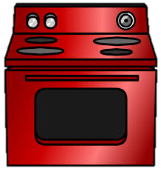
Electric cooker

Slide 2
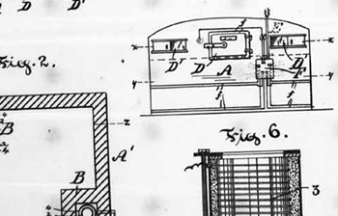
1892
Canadian inventor Thomas Ahearn filed patent number no. 39916 in 1892 for an "Electric Oven„.

Slide 3
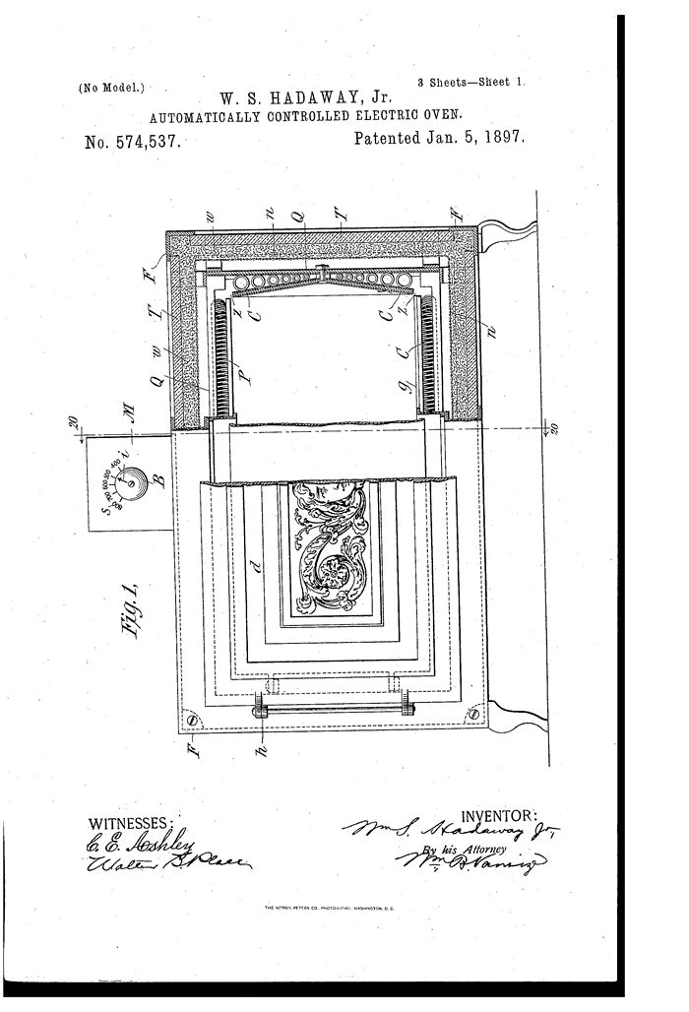
1897
In 1897, William Hadaway was granted US patent # 574537 for an "Automatically Controlled Electric Oven„.

Slide 4
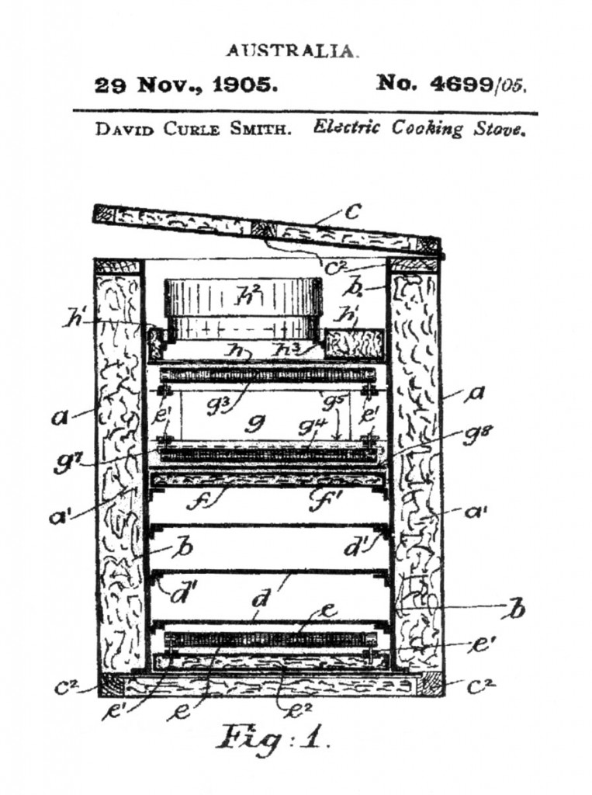
1905
In November 1905, David Curle Smith, Western Australia, applied for a patent for a device that adopted what later became the configuration for most electric stoves: an oven surmounted by a hotplate with a grill tray between them.

Slide 5
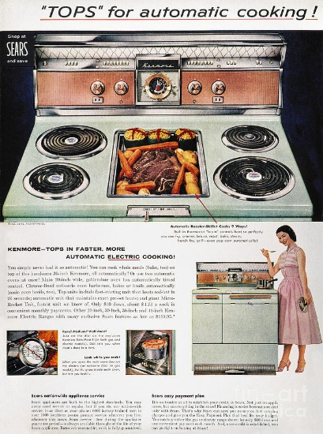
1960s

Slide 6
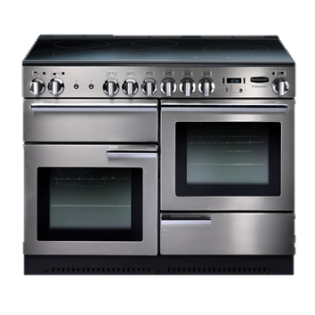
Today
Today: Stainless steel double-layer cooker. There are dozens of options for cooking available today compared to yesterday's years.

Slide 7
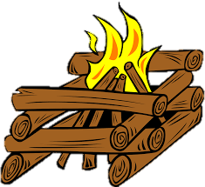
Fortunately, you do not have to cook dinner over an open fire tonight!

Slide 8
Source:
https://en.wikipedia.org/wiki/Electric_stove

Slide 9
Created for the eTwinning poject: On the Track of Our Recent Past by: Paula Horvat, 6th grade teacher: Iva Naranđa II. OŠ Čakovec, Croatia May, 2016

