Slide 1
GRAMOPHONE GRAMOPHONE RECORDS

Slide 2
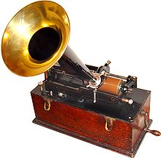
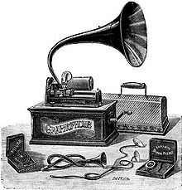
History of the gramophone
Early attempts to design a consumer sound or music playing gadget began in 1877 when Thomas Edison invented his tin-foil phonograph. The sound quality on the phonograph was bad and each recording lasted for one only play.
Edison's phonograph was followed by Alexander Graham Bell's graphophone. The graphophone used wax cylinders which could be played many times.
1887 Emile Berliner invents the gramophone and records.

Slide 3
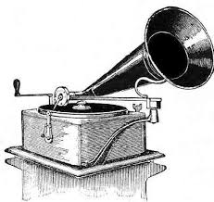
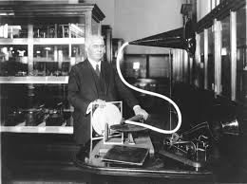
Emile Berliner in 1887
1909

Slide 4
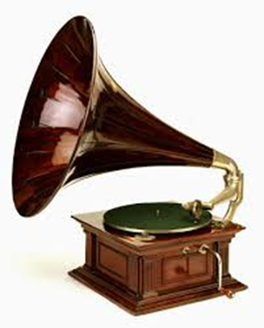
The gramophone
1928
1925

Slide 5
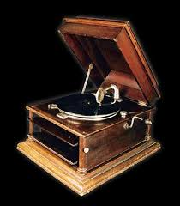
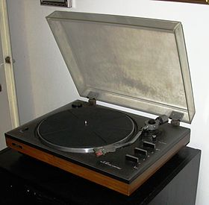
1938
1980

Slide 6
Something about gramophone records
A gramophone record or vinyl record is a kind of analogue sound storage medium in the form of a flat polyvinyl chloride disc with an inscribed, modulated spiral groove. The groove usually starts near the periphery and ends near the center of the disc.
Gramophone records are generally described by their diameter in inches (12", 10", 7"), the rotational speed in rpm at which they are played, and their time capacity resulting from a combination of those parameters (LP – long playing 33 ¹⁄₃ rpm, SP – 78 rpm single…).

Slide 7
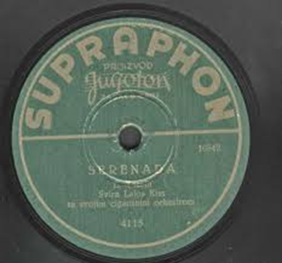
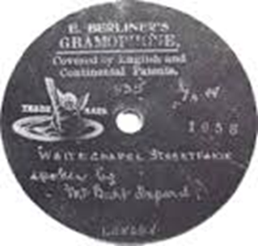
Gramophone records

Slide 8
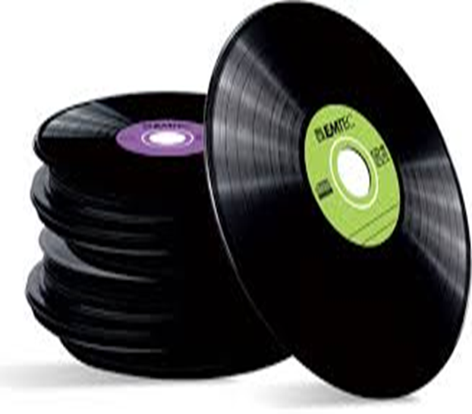
Gramophone records

Slide 9
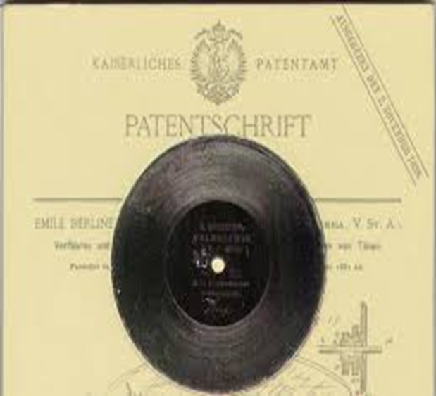
Covers of gramophone records

Slide 10
Created by:
Daniel Turk, 6th grade
II. osnovna škola Čakovec, Croatia
Teacher: Iva Naranđa
eTwinning project On the Track of Our Recent Past
Sources:
https://en.wikipedia.org/wiki/Phonograph
http://inventors.about.com/od/gstartinventions/a/gramophone.htm
https://sh.wikipedia.org/wiki/Gramofon

