Slide 1
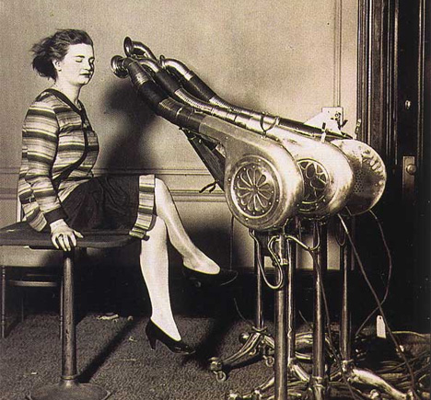
The History of the Hair Dryer
By Ema Bilaver

Slide 2
The Definition of a Hair Dryer
A hair dryer or blow dryer is an electromechanical device designed to blow normal or hot air over damp hair, in order to accelerate the evaporation of water particles and dry the hair.
Blow dryers are used both in beauty salons by professional stylists, and in the average household by consumers.

Slide 3
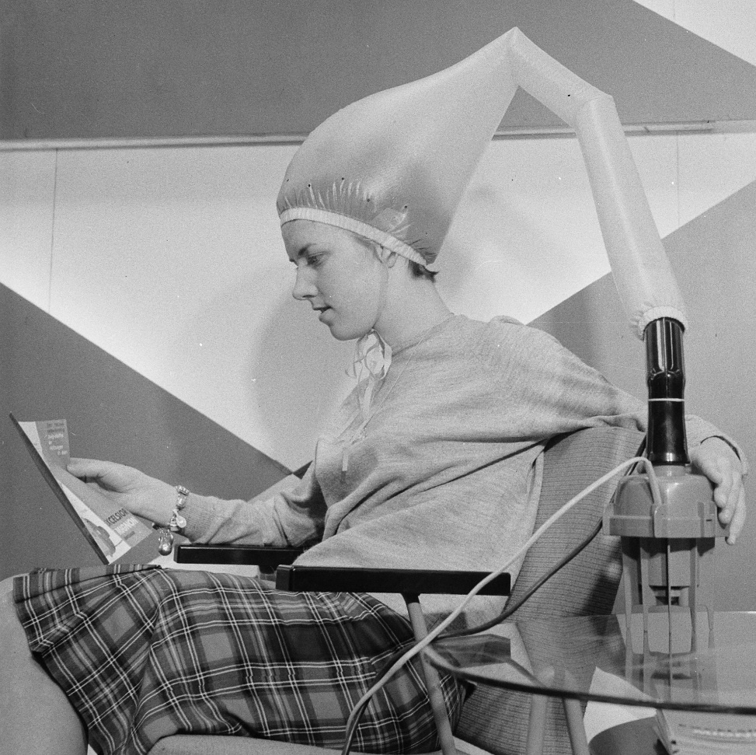
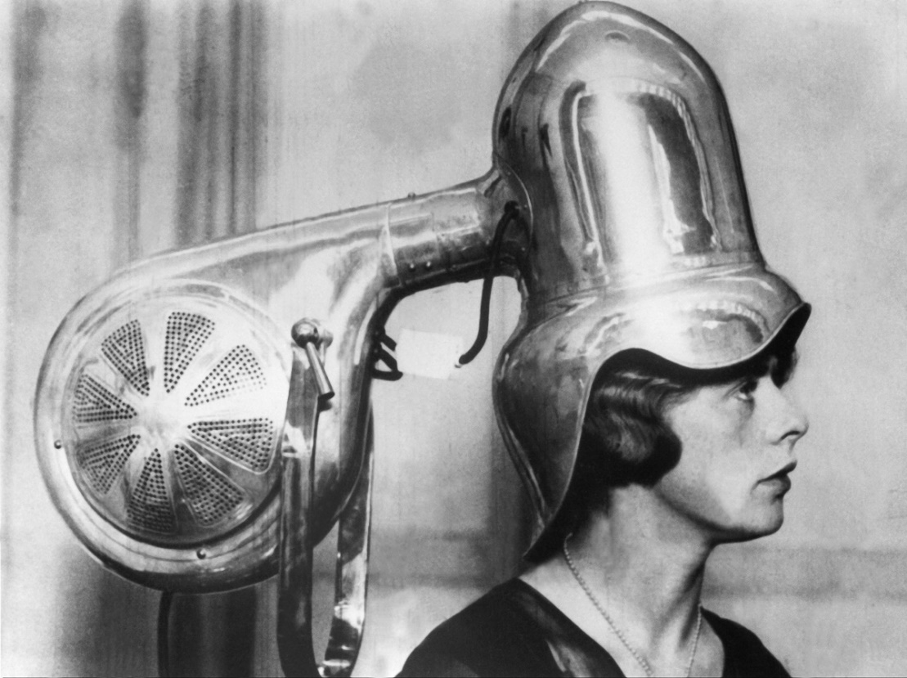
First appearance

Slide 4
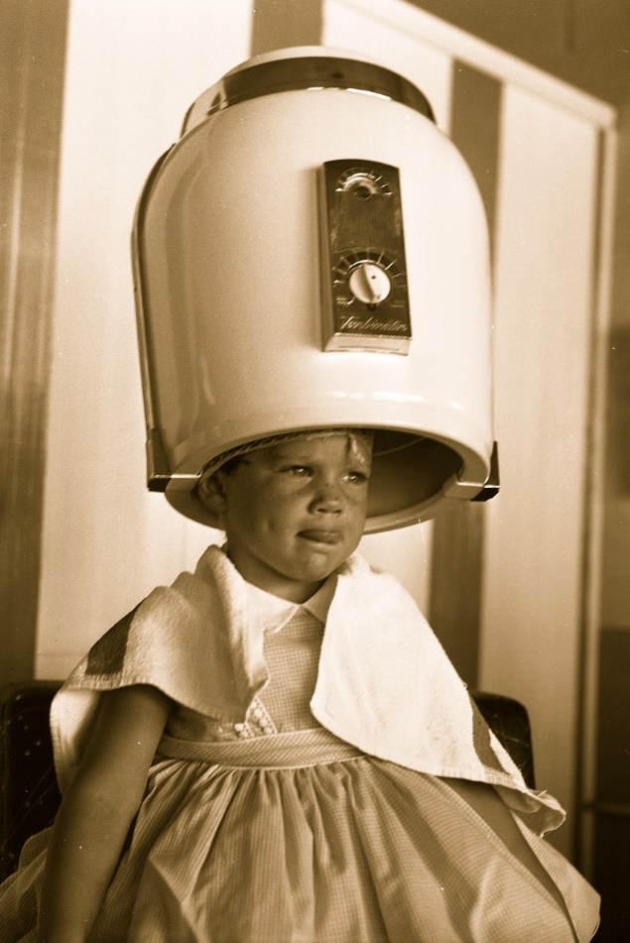
First appearance
In 1890 the first hairdryer was invented by a french stylist, Alexander Godefroy. His invention was a large, seated version that consisted of a bonnet that attatched to the chimney pipe of a gas stove. Godefroy invented it for use in his hair salon in France.

Slide 5
First appearance
A hair hood dryer has a hard plastic dome that comes down and fits over a person's head in order to dry their hair. Hot air is blown out through the tiny openings around the inside of the dome so the person's hair is dried evenly.
It was an Armenian American inventor Gabriel Kazanjian who patented the first blow dryer in America in 1911.

Slide 6
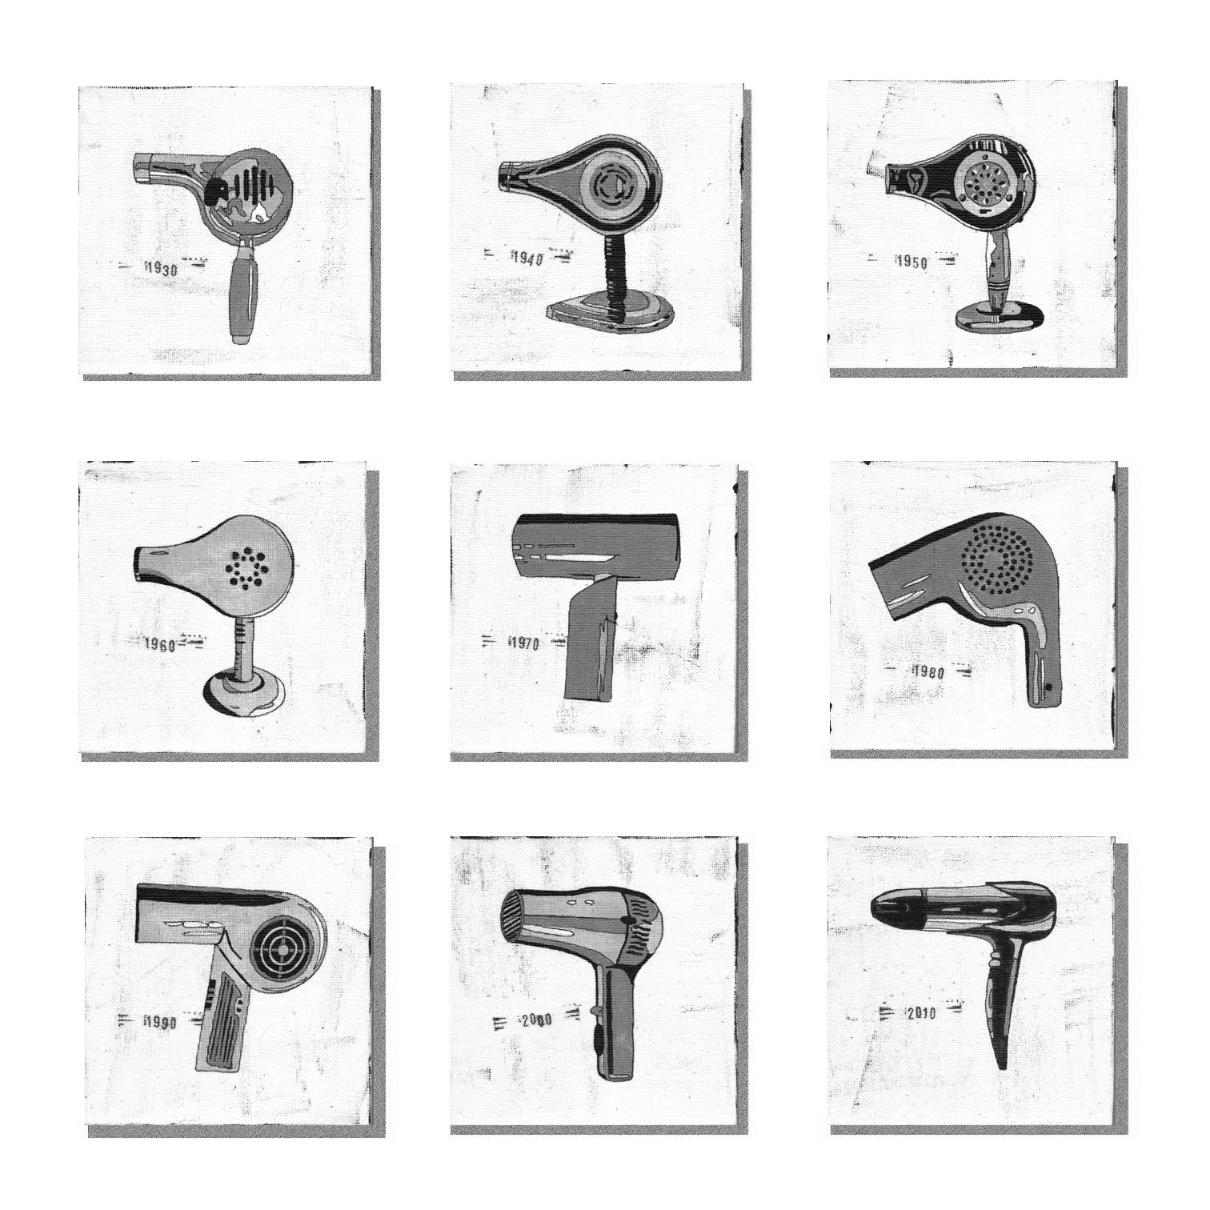
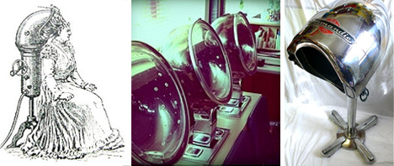
Evolution

Slide 7
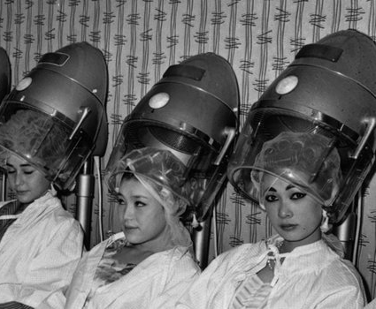
evolution
It was not until around 1915 that the hair dryer began to go on the market in handheld form. This was due to innovations by National Stamping and Electricworks under the white cross brand, and later U.S. Racine Universal Motor.

Slide 8
evolution
Since the 1920s, development of the hair dryer has mainly focused on improving the wattage and superficial exterior and material changes. In fact, the mechanism of the dryer has not had any significant changes since its inception. One of the more important changes for the hair dryer is having the materials change to plastic so that it is more lightweight.

Slide 9
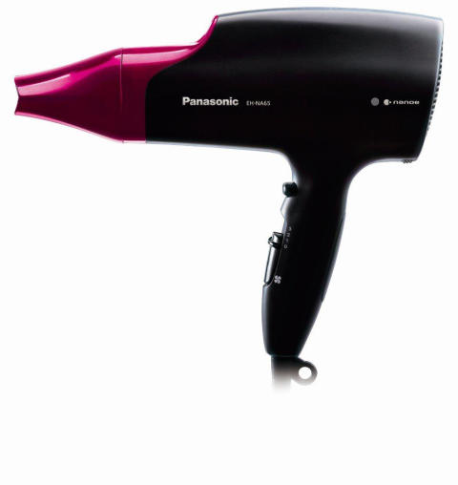
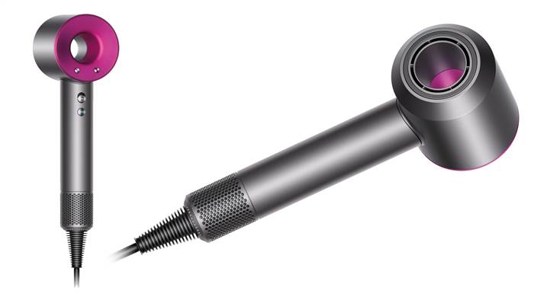
Hair dryers today

Slide 10
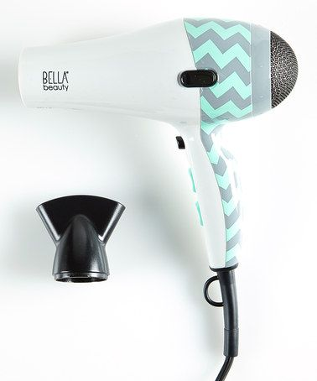
Hair dryers today
By 2000, deaths by blow dryers had dropped to fewer than four people a year, a stark difference to the hundreds of cases of electrocution accidents during the mid-twentieth century. In terms of positive health, this type of dryer has also been cited as an effective treatment for head lice.

Slide 11
Hair dryers today
The size, weight, noise, and appearance of the hair dryer has dramatically changed from the heavy, bulky, and noisy contraptions of the early twentieth century, to the streamlined plastic people are used to today.
There are two other major types of blow: the bonnet hair dryer and the rigid-hood dryer. The bonnet dryer, introduced in 1951, worked by having the dryer connected to a tube that went into a bonnet with holes in it, placed on top of a person's head. The rigid-hood dryer had a plastic helmet that went over the head. It worked similarly to the bonnet dryer, but at a much higher wattage.

Slide 12
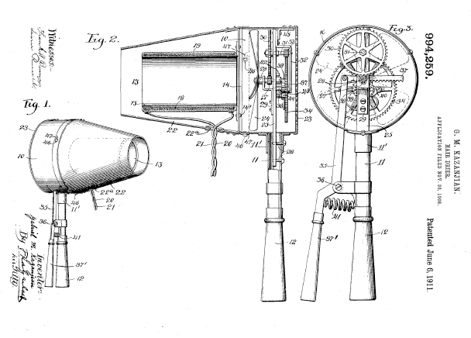
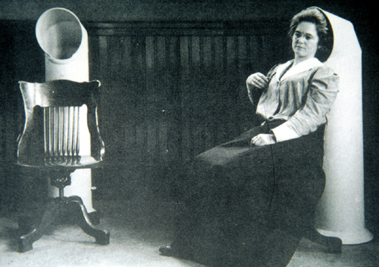
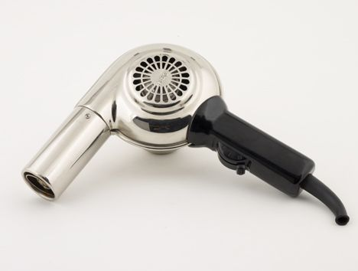
Visual history
1890
1911
1915

Slide 13
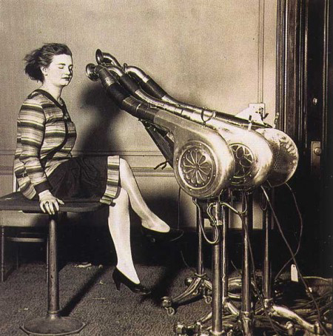
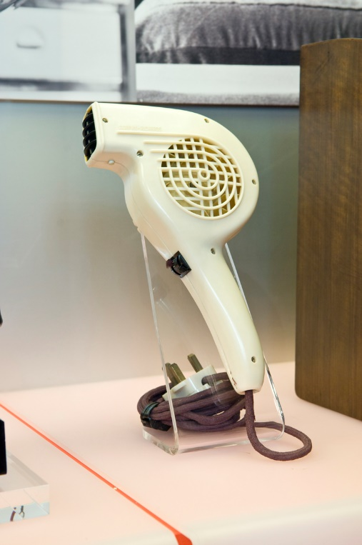
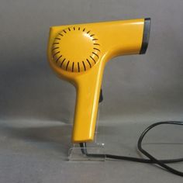
Visual history
1920
1960
1970

Slide 14
Visual history
2000

Slide 15
The history of the hair dryer eTwinning project: on the track of our recent past
Ema Bilaver, 6th grade
II. osnovna škola Čakovec, Croatia
Teacher: Iva Naranđa
Source:
https://en.wikipedia.org/wiki/Hair_dryer

