Slide 1
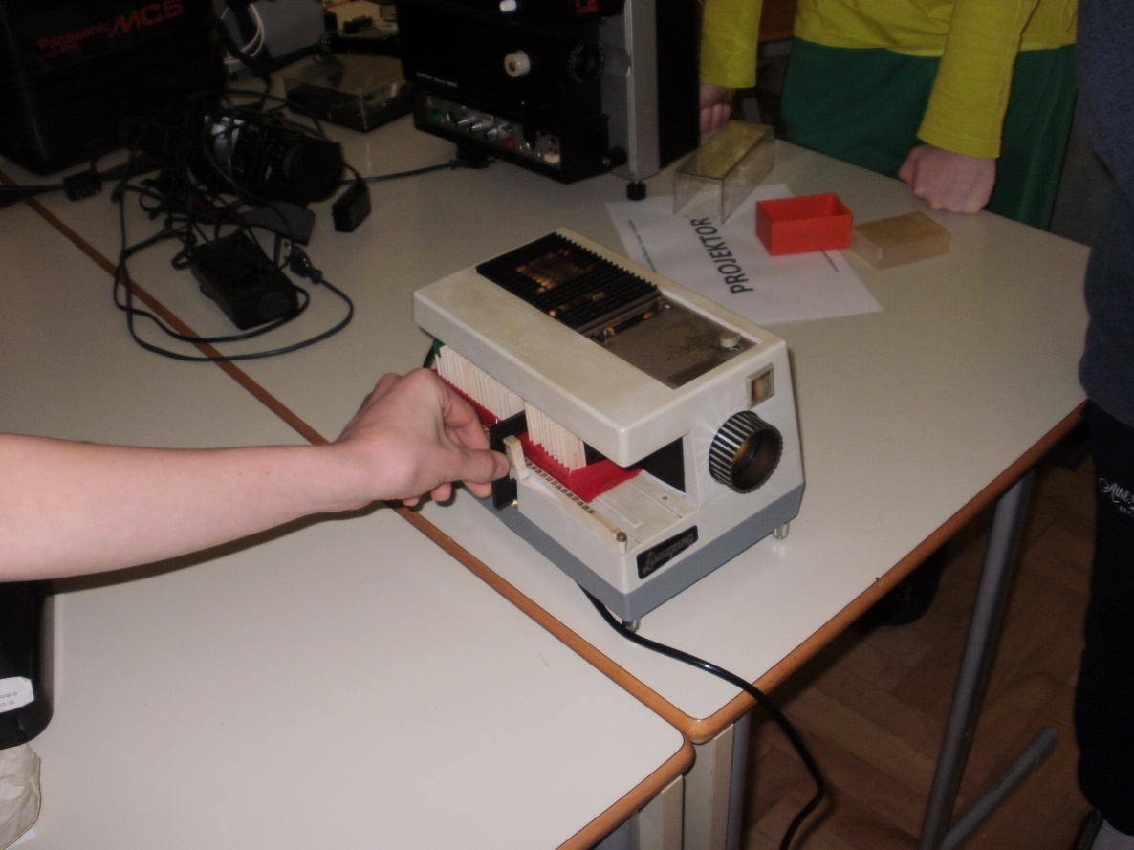
Projector

Slide 2
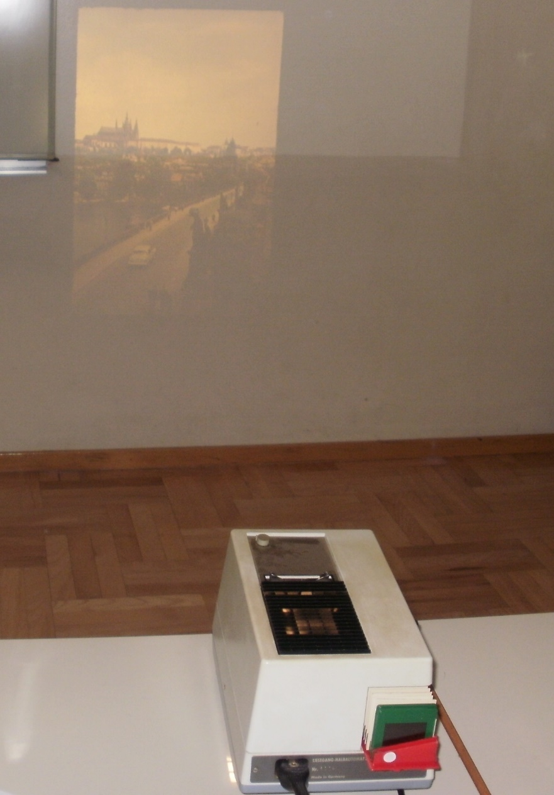
Projector
A projector or image projector is an optical device that projects an image (or moving images) onto a surface, commonly a projection screen.
The first known record of what might portray the idea of projecting an image on a surface is a drawing by Johannes de Fontana from 1420.

Slide 3
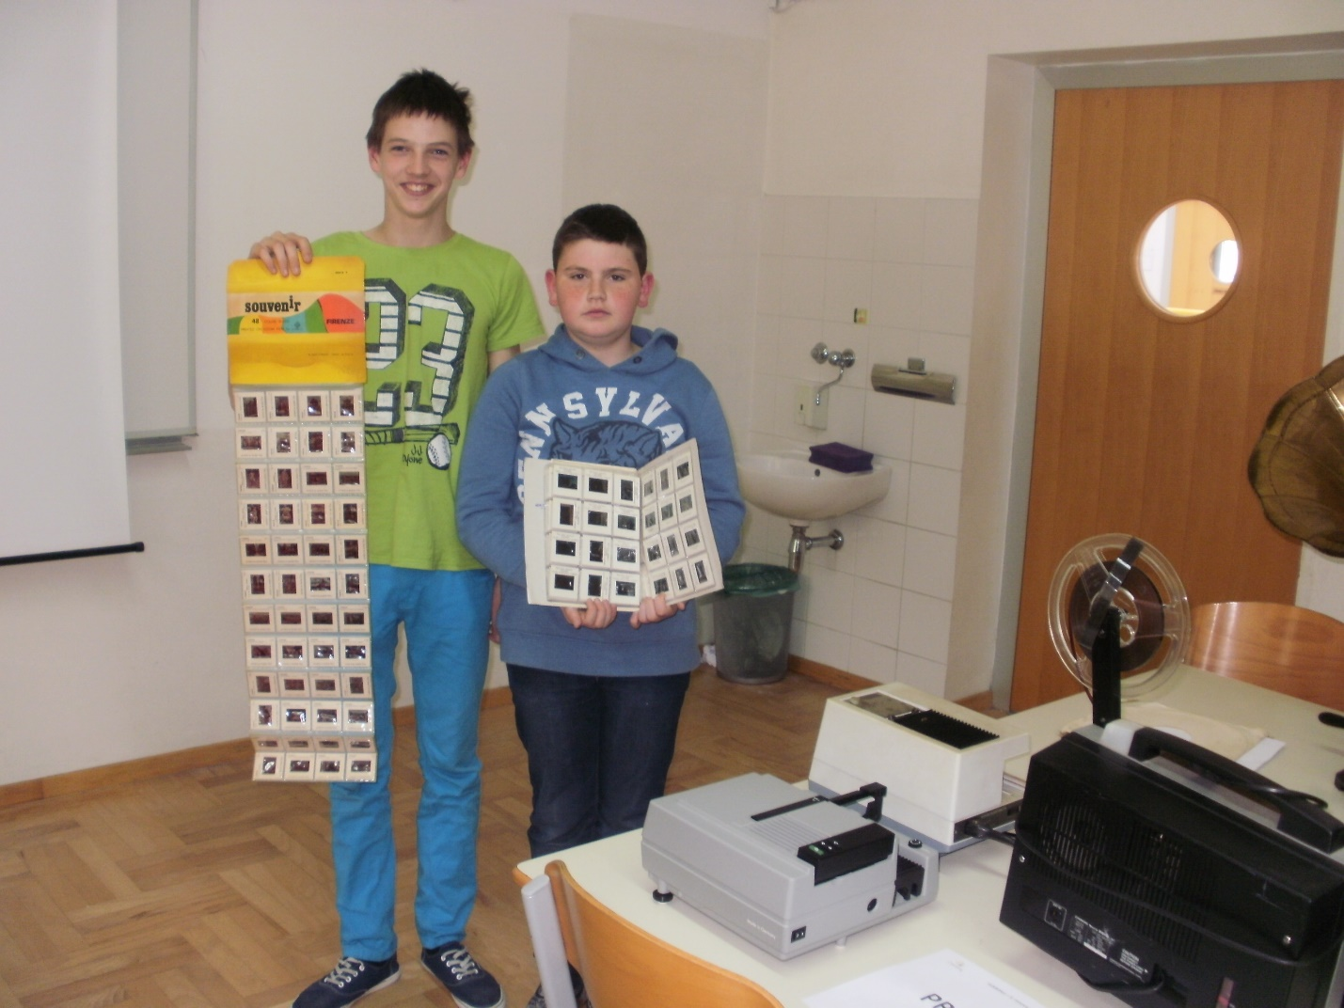
This are Slides

Slide 4
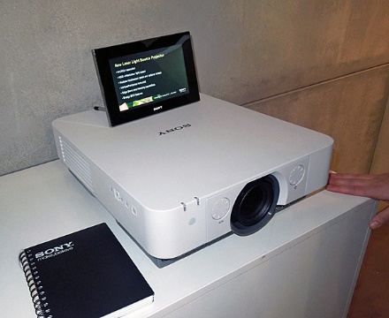
The most popular projector
The most common type of projector used today is called a video projector.
https://en.wikipedia.org/wiki/Projector

Slide 5
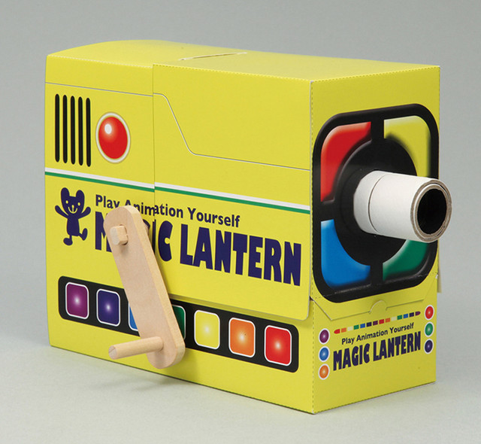
Toy projector
In the early and middle parts of the 20th century, a new type of low-cost projectors called opaque projectors were produced and marketed as toys for children.

Slide 6
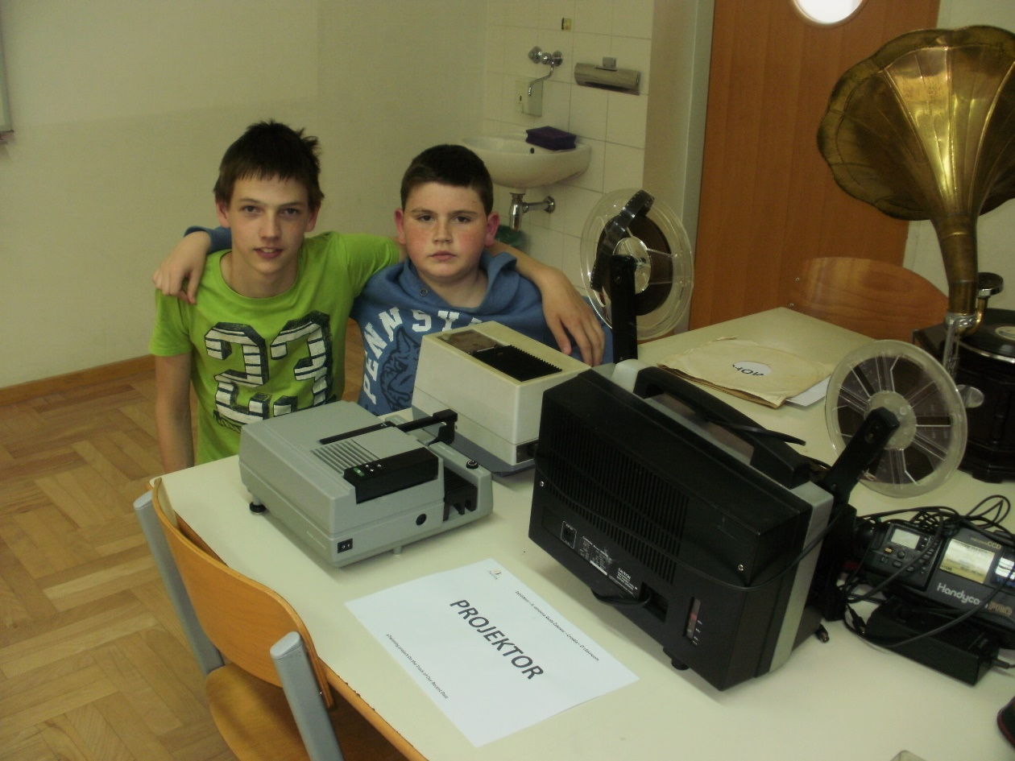
On the Track of Our Recent Past
eTwinning project
II. osnovna škola Čakovec
Croatia
Teacher: Iva Naranđa
Hrvoje Vurušić, 6th grade
May 2016

