Slide 1
Projector
eTwinning project On the Track of Our Recent Past
II. osnovna škola Čakovec, Croatia
Mateo Žbulj, 6th grade
Teacher Iva Naranđa

Slide 2
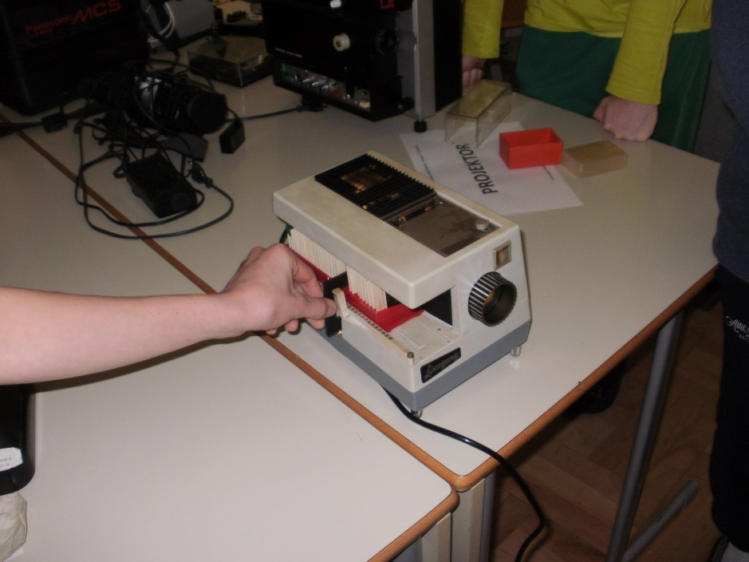
Liesegang Halb-Automat 12V

Slide 3
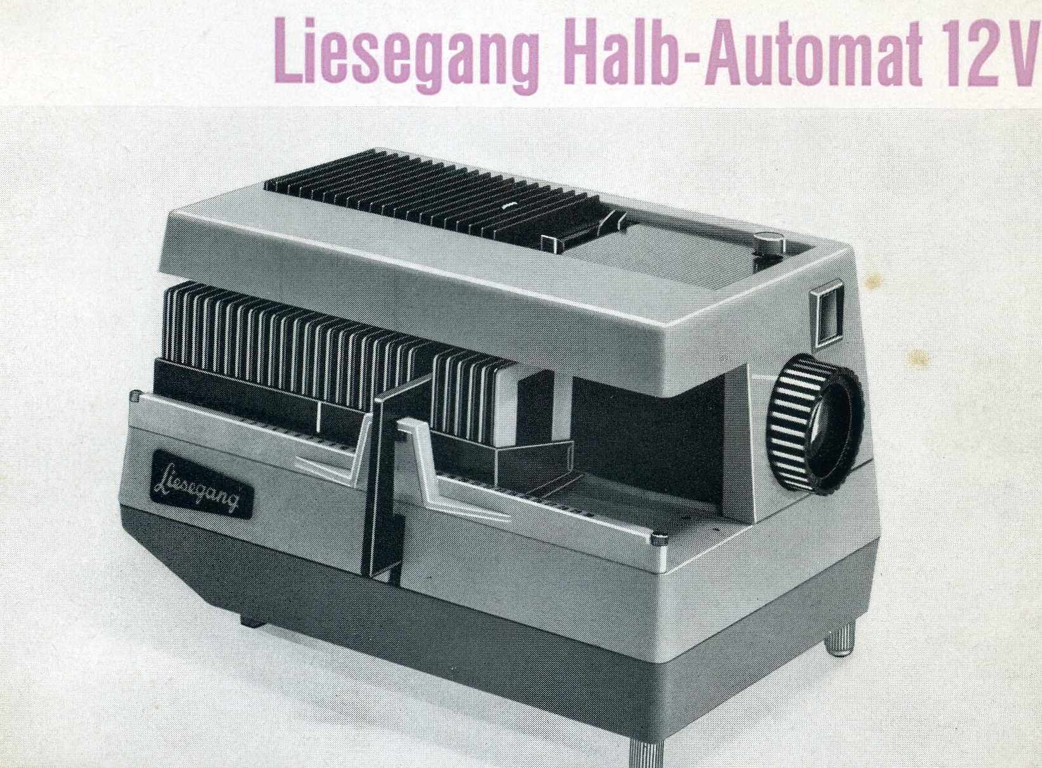
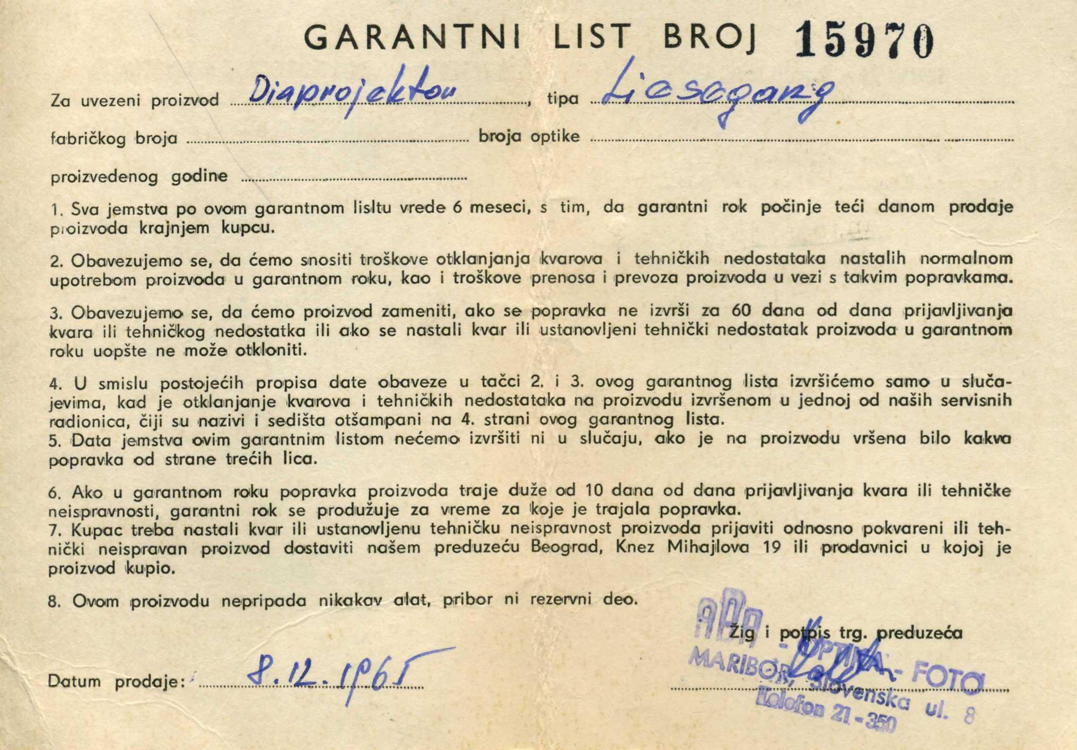

Slide 4
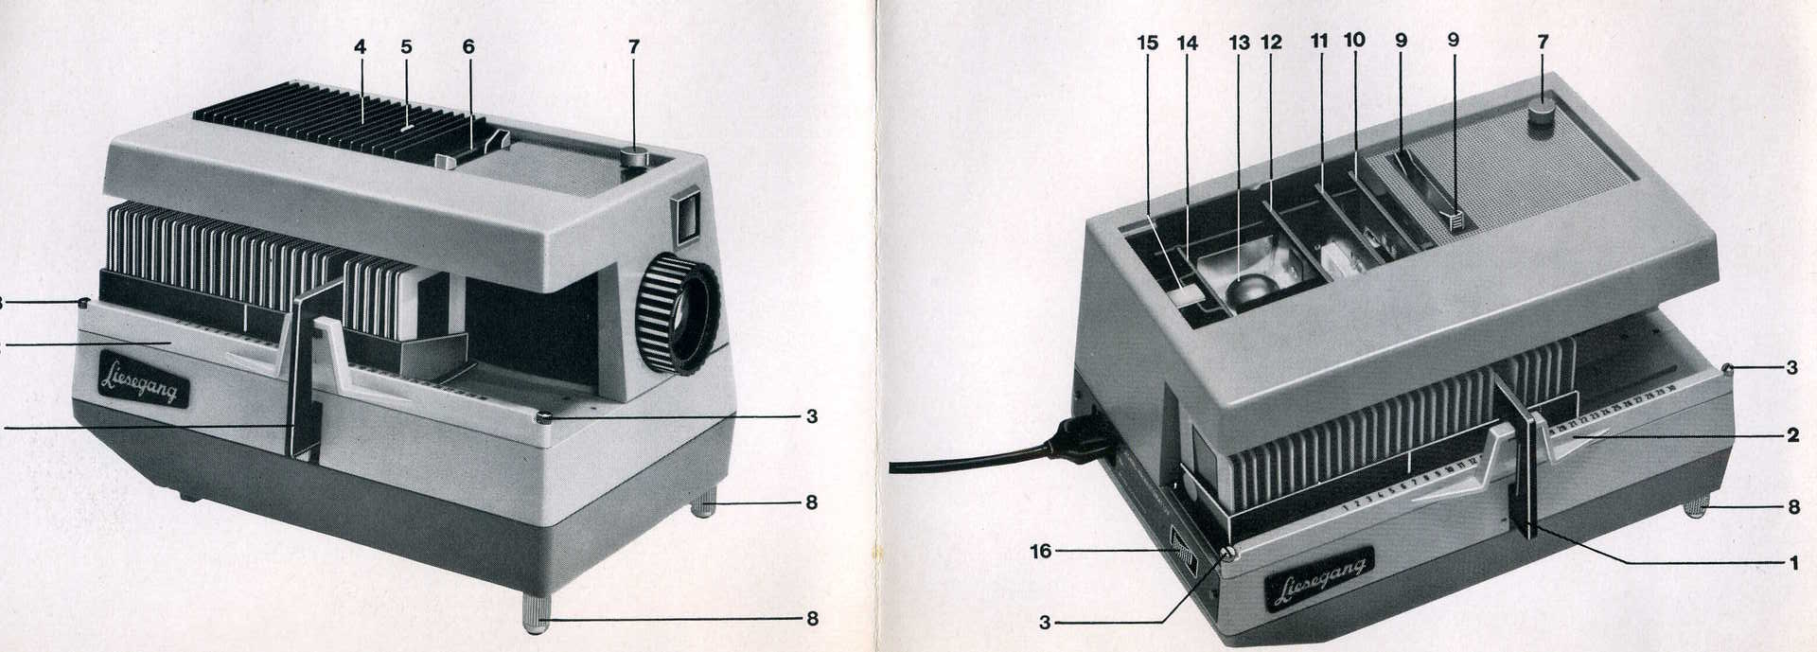

Slide 5
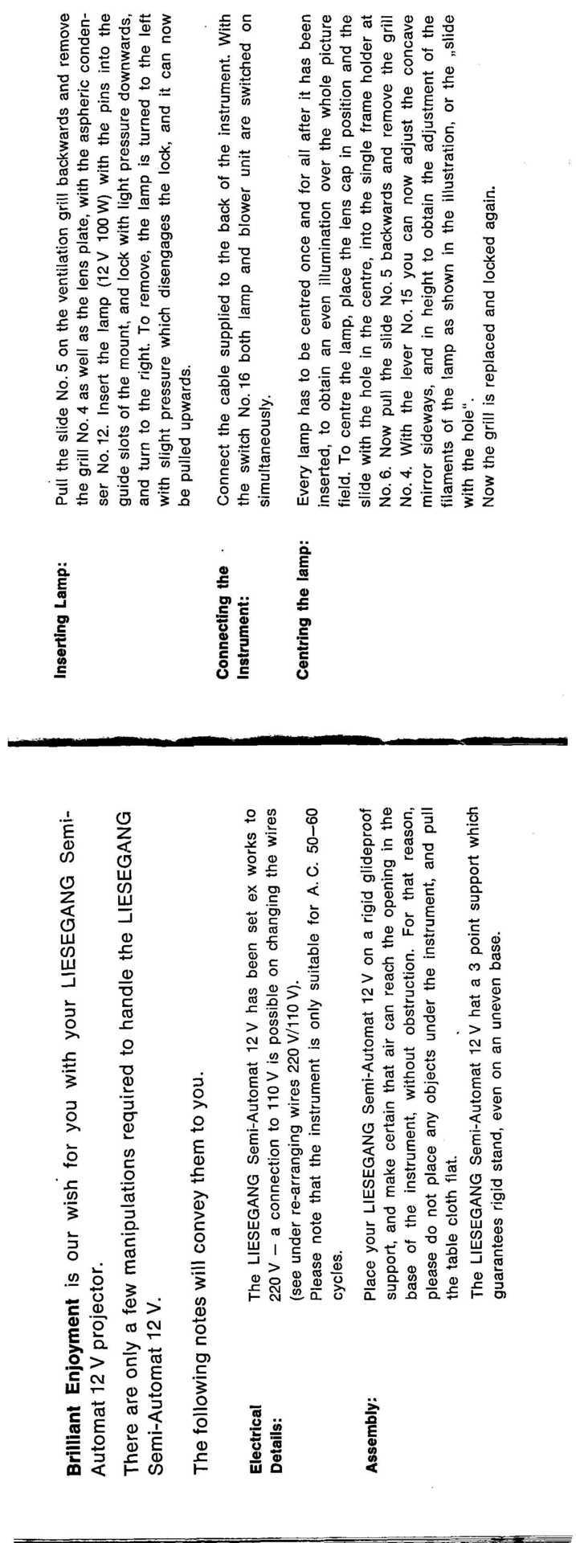

Slide 7
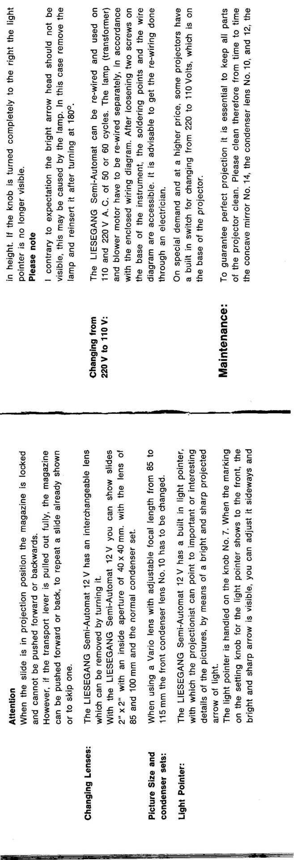

Slide 9
