Slide 1
The history of refrigerators
Melani Anderlin, 6th grade
II. osnovna škola Čakovec, Croatia
Teacher: Iva Naranđa
eTwinning project On the Track of Our Recent Past

Slide 2
Refrigerator
The refrigerator is a popular household appliance.
It replaced the icebox.
The first cooling systems for food involved using ice.

Slide 3
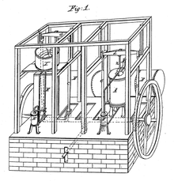
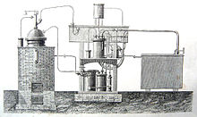
Before the invention of the refrigerator, icehouses were used to provide cool storage for most of the year.
The history of artificial refrigeration began when a Scottish proffesor William Cullen designed a small refrigerating machine in 1755.
Schematic of Dr. John Gorrie's 1841 mechanical ice machine.
Ferdinand Carré's ice-making device

Slide 4
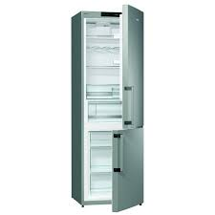
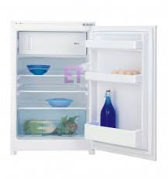
Modern refrigerators
People put food and drinks in it, to keep those items cold or good for a longer time.
The most modern refrigerators are available in a variety of colours.

Slide 5
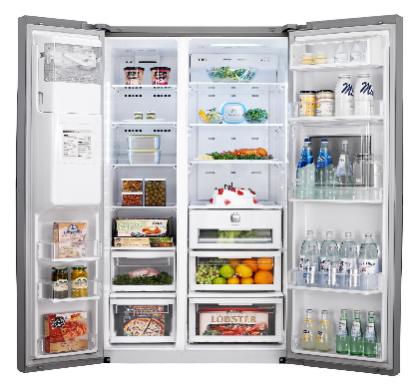
Modern refrigerators

Slide 6
Food stored in a refrigerator or a freezer also has a limited shelf life.
But times have changed, with manufacturers increasingly thinking outside of the icebox to try to redefine what the modern refrigerator is really capable of.
Today, a shopper will find an ever-increasing range of color and style options.

Slide 7
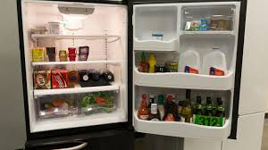
Refrigerators

Slide 8
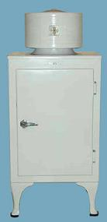
Source
https://en.wikipedia.org/wiki/Refrigerator

