Slide 1
Tape recorder
Through history

Slide 2
Tape recorder, tape deck or tape machine
A tape recorder is an analog audio storage device that records and plays sounds.
Includes articulated voices, usually using magnetic tape, either wound on a reel or in a cassete.
The sound can be recorded, erased and re-recorded.

Slide 3
The earliest known audio tape recorder was a non-magnetic, non-electric version invented by Alexander Graham Bell's Volta Laboratory and patented in 1886.

Slide 4
Early steel tape recorders
In 1924 a German engineer, Dr. Kurt Stille, developed the Poulsen wire recorder as a dictating machine. The following year a fellow German, Louis Blattner, working in Britain, licensed Stille's device and started work on a machine which would instead record on a magnetic steel tape, which he called the Blattnerphone.

Slide 5
Parts of a tape recorder
Reproduction torso
Recording torso
Tape carriers
Tape
Volume booster
Speaker
Microphone volume booster
Microphone

Slide 6
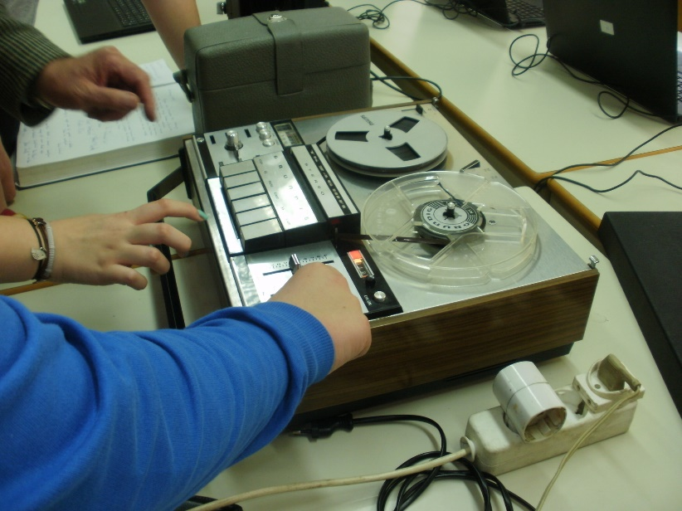
Limitations
The storage of an analogue signal on tape works well, but is not perfect (the granular nature of the magnetic material adds high-frequency noise to the signal, generally referred to as tape hiss).
The magnetic characteristics of tape are not linear.
Different tape material requires differing amounts of bias, which is why most recorders have a switch to select this.

Slide 7
TAPEDECK SPEED
Common tape speeds
Cm/s | In/s
1.2 | 15/32
2.4 | 15/16
4.75 | 1 7/8
9.5 | 3 3/4
19 | 7 1/2
38 | 15
76 | 30

Slide 8
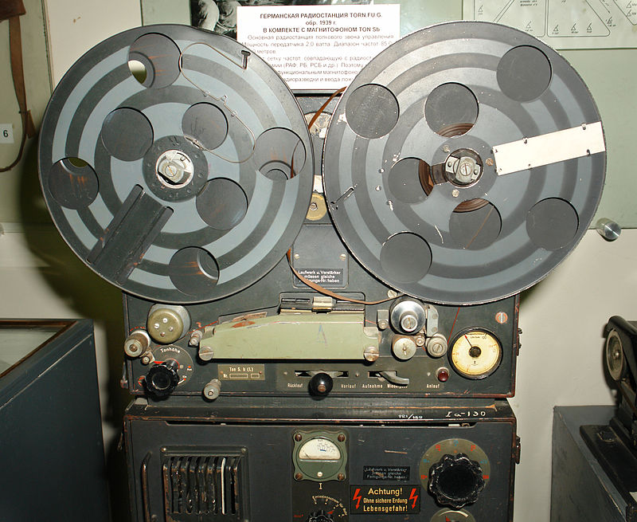
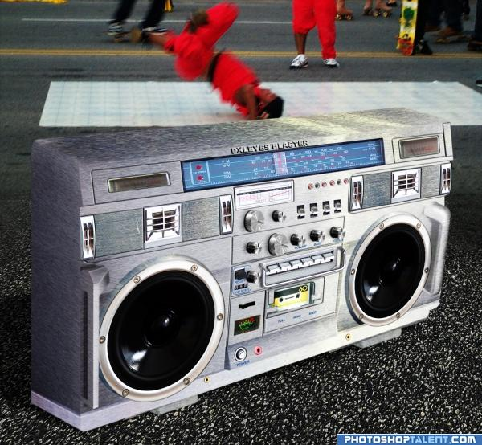
Modern tape recorders
Magnetic tape recording as we know it today was developed in Germany during the 1930s at BASF.
The first practical tape recorder from AEG was the Magnetophon K1, demonstrated in Germany in 1935.

Slide 9
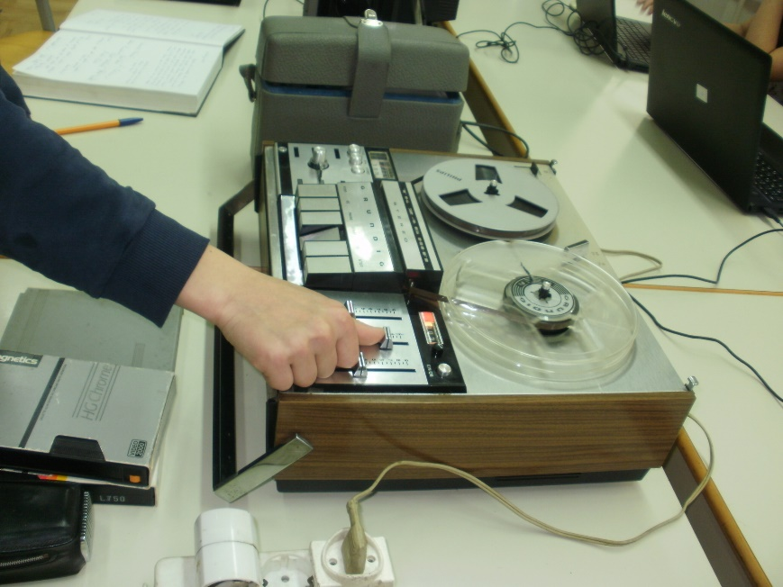
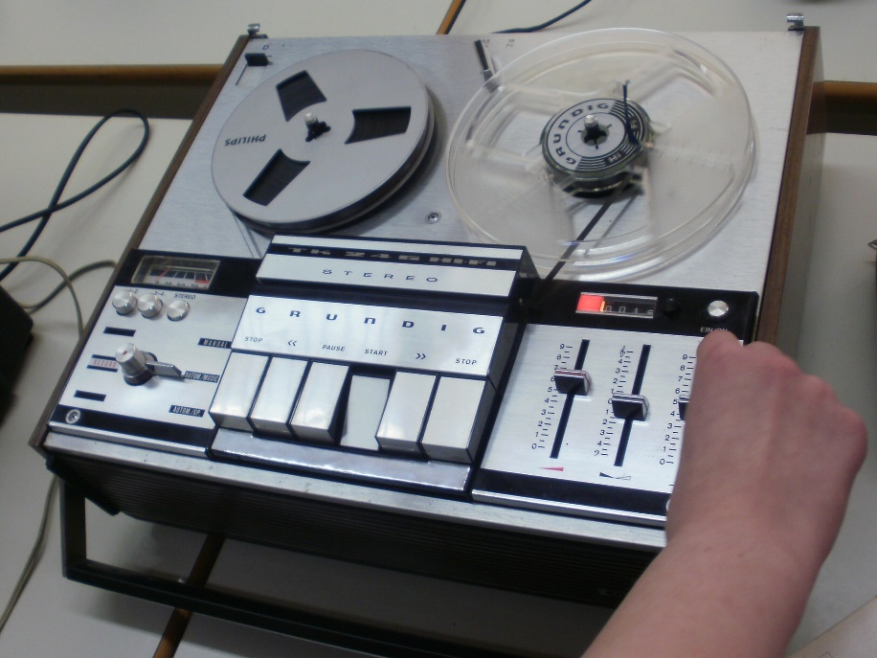
Tape recorder brought in our school

Slide 10
On the track of our recent past
eTwinning project
Ema Balent, 6th grade
II. osnovna škola Čakovec, Croatia
Teacher: Iva Naranđa
May 2016
Source: https://en.wikipedia.org/wiki/Tape_recorder

