Slide 1
Tape recorder
On the Track of Our Recent Past eTwinning project

Slide 2
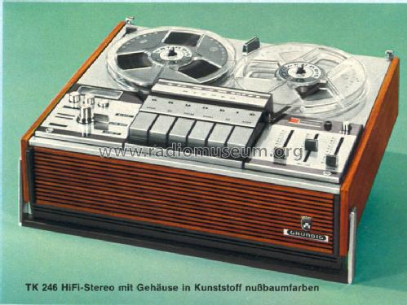
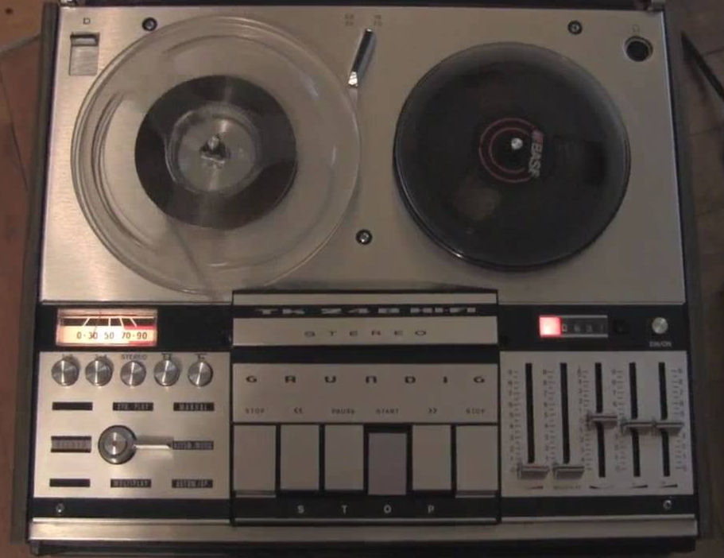
Grundig tk 246 hi-fi stereo
Factory: Grundig
Production: 1970 – 1972

Slide 3
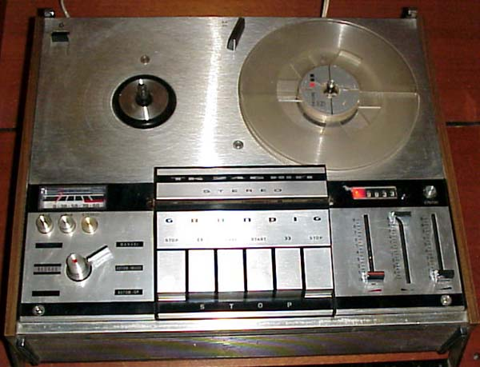
interesting facts
Mono amplifier (possible only through an amplifier)
Dimensions: 430 x 170 x 360 mm
Power supply: 110, 120 V
Weight: 11 kg
Sound settings (distortion, equalization…)

Slide 4
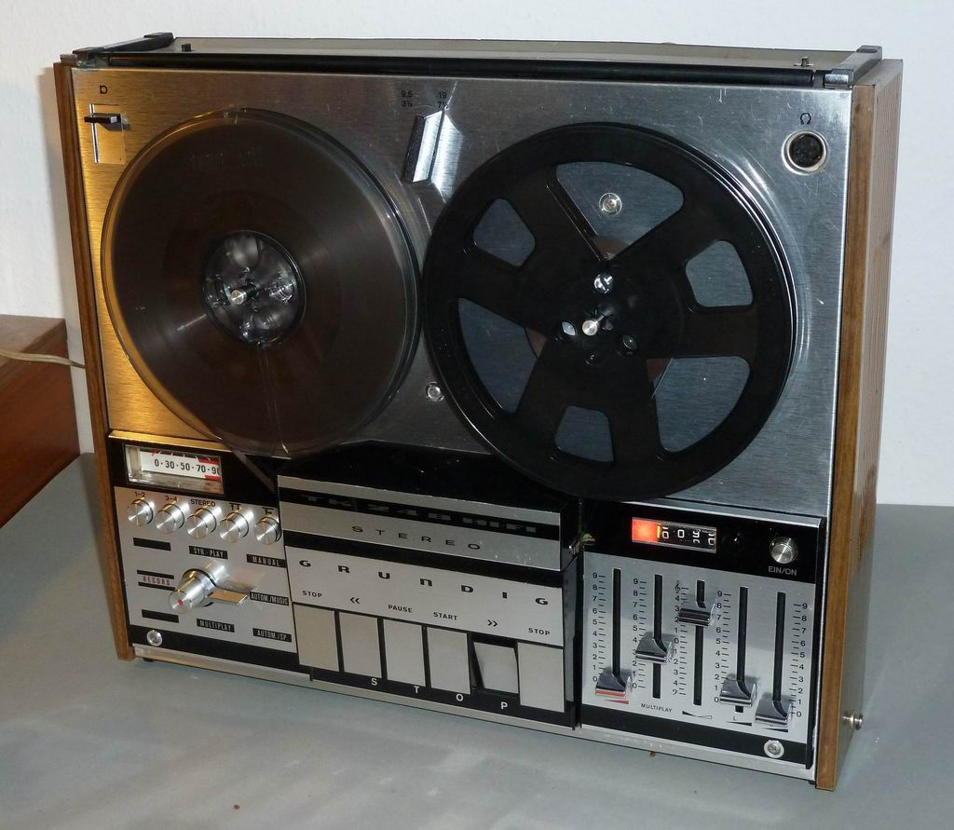

Slide 6
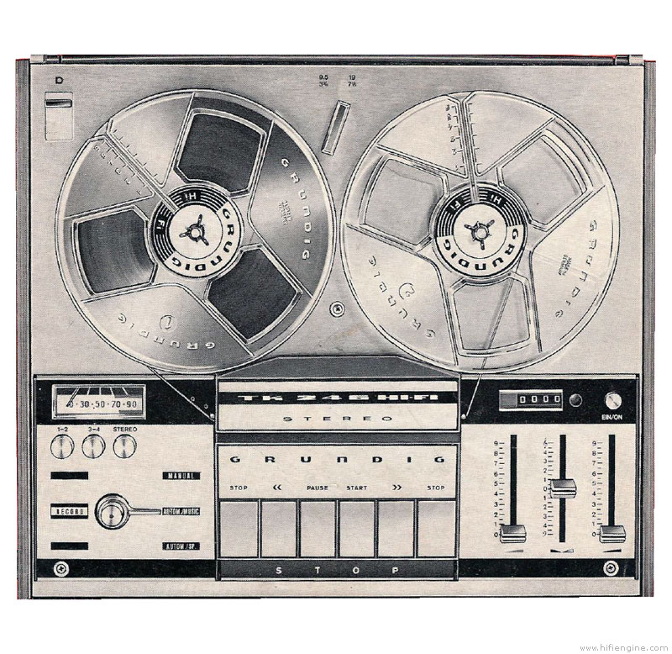

Slide 7
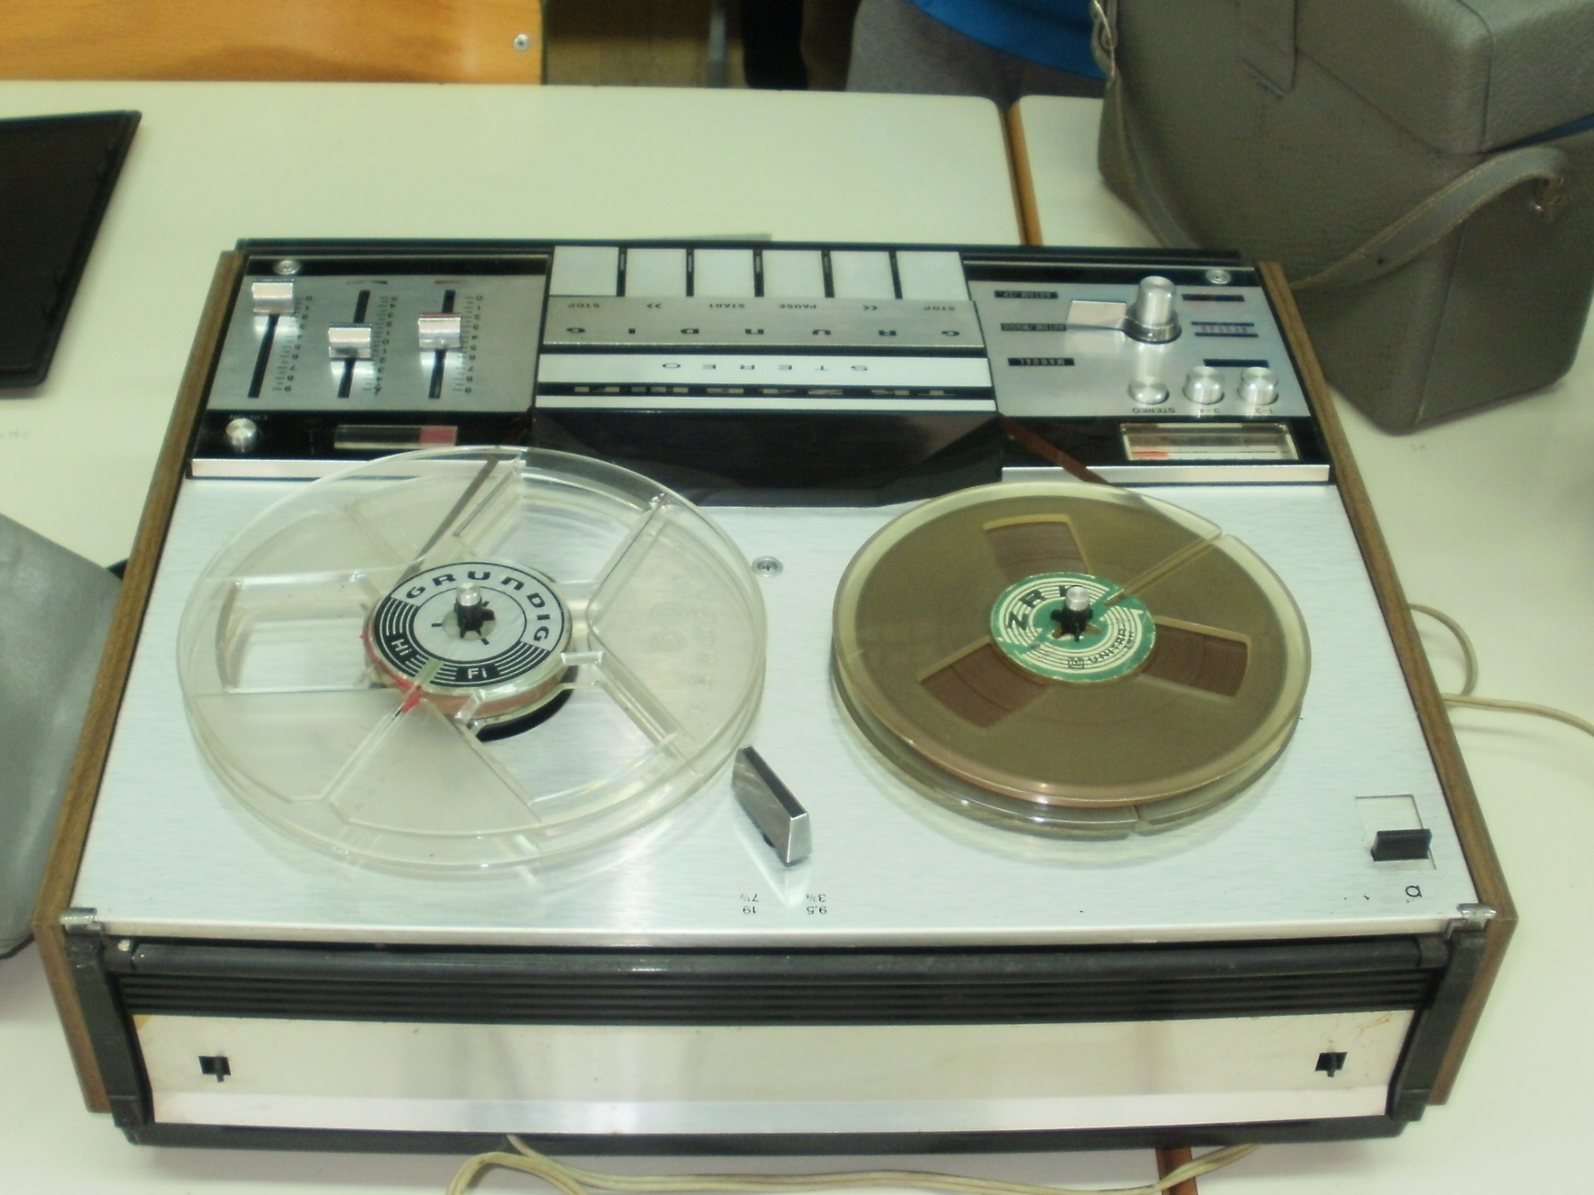
In our school

Slide 8
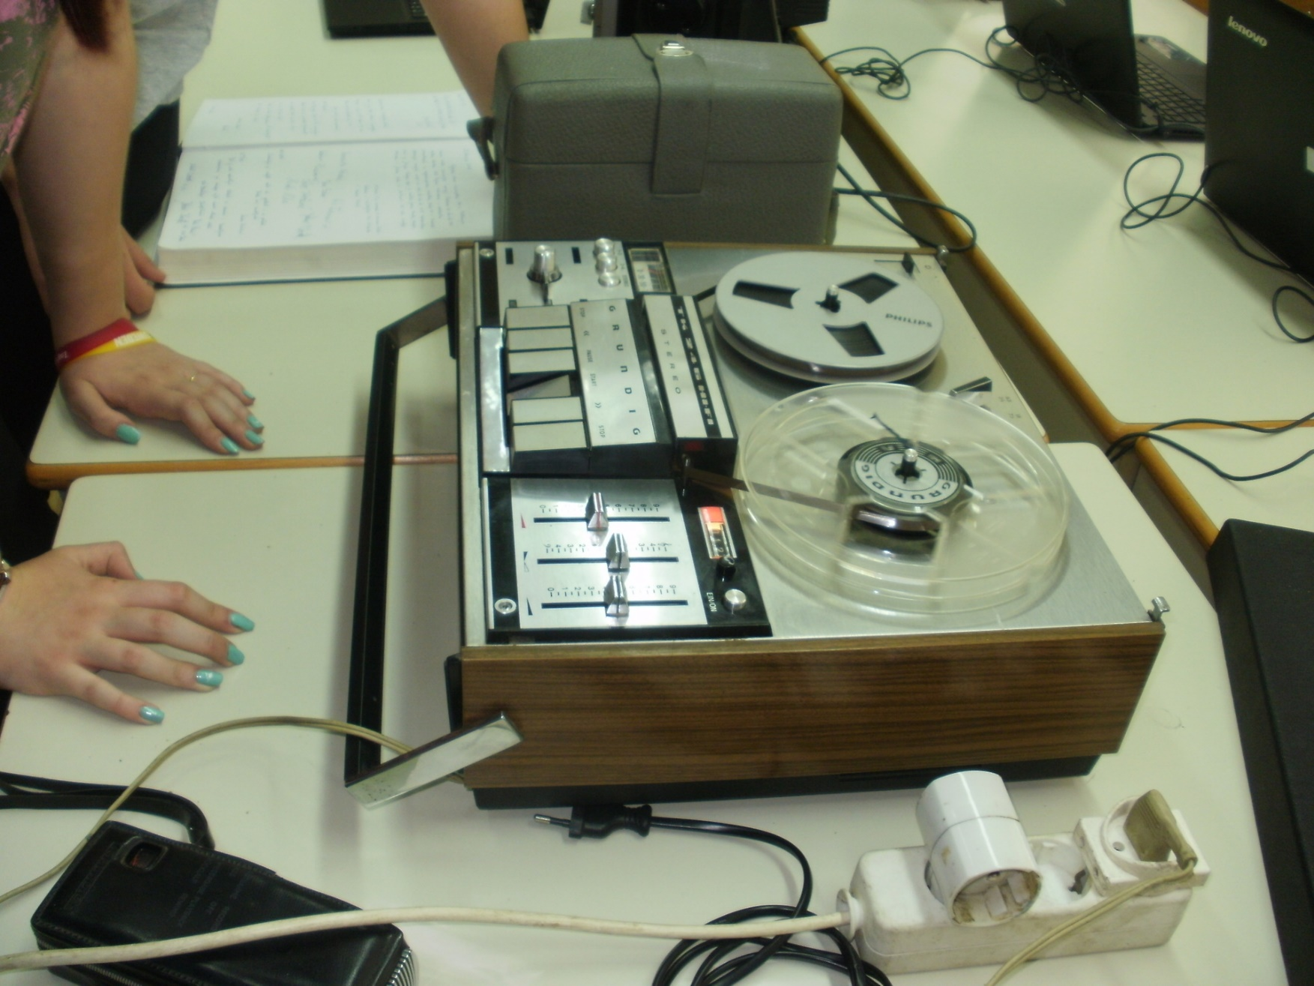
In our school

Slide 9
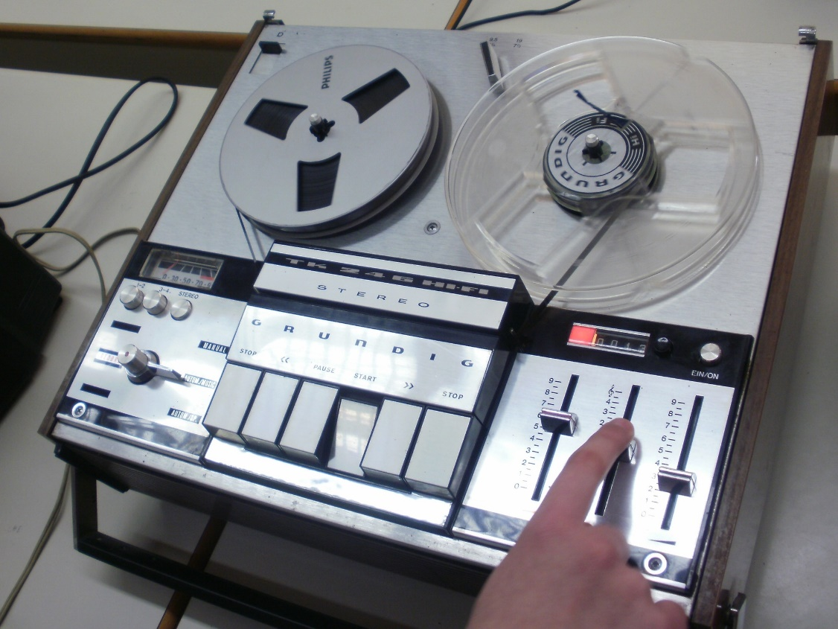
Fran Železnjak, 6th grade
II. osnovna škola Čakovec, Croatia
May 2016
Teacher: Iva Naranđa

