Slide 1
On the Track of Our Recent Past eTwinning project

Slide 2
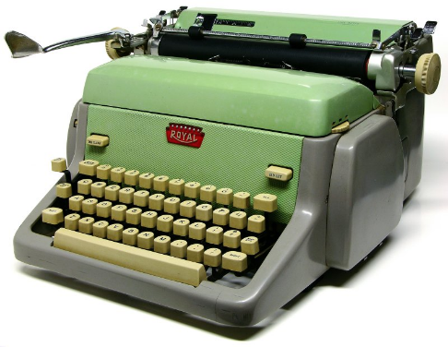
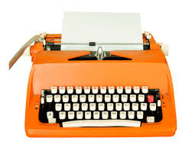
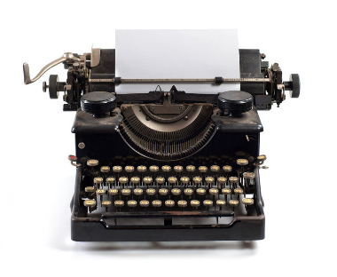
OLD TYPEWRITERS
A typewriter is a mechanical or electromechanical machine for writing in characters similar to those produced by printer's movable type by means of keyboard-operated types striking a ribbon to transfer ink or carbon impressions onto paper.

Slide 3
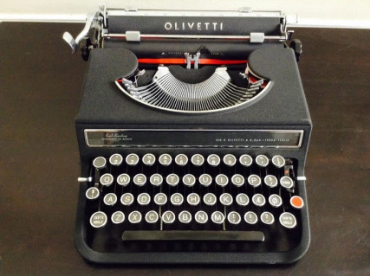
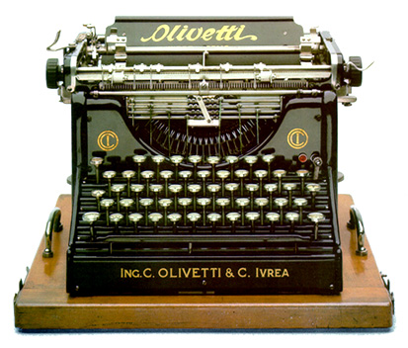
OLIVETTI
Olivetti is an Italian manufacturer of typewriters, computers, tablets, smartphones, printers and other such business products as calculators and fax machines.
Typewriters coming
from 1908:

Slide 4
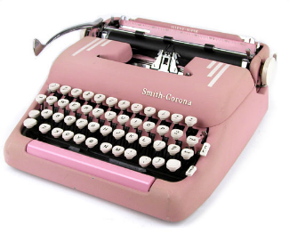
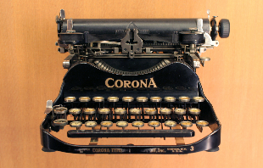
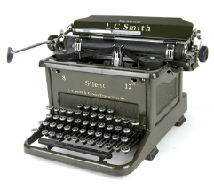
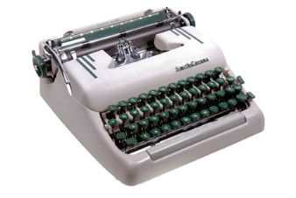
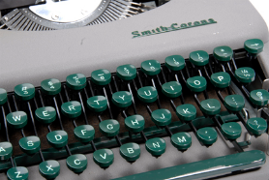
SMITH CORONA
Once a large U.S. typewriter and mechanical calculator manufacturer, it expanded aggressively during the 1960s to become a broad-based industrial conglomerate whose products extended to paints, foods, and paper.
The Smith Premier Typewriter Company was established in 1886 by brothers Lyman Cornelius Smith, Wilbert Smith, Monroe C. Smith and Hurlbut Smith who were born in Lisle, New York.

Slide 5
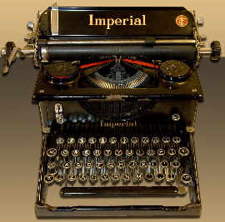
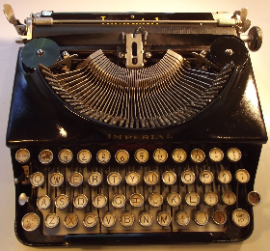
IMPERIAL TYPEWRITERS
The Imperial Typewriter Company was a British manufacturer of typewriters based in Leicester, England
The company was founded by Hidalgo Moya, an American- Spanish engineer who lived in England
After first building the Moya typewriter, he set up the Imperial Typewriter Company in Leicester
It stopped manufacturing typewriters when personal computers became popular causing typewriter sales to fall.

Slide 6
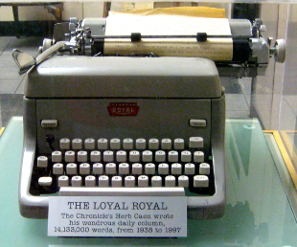
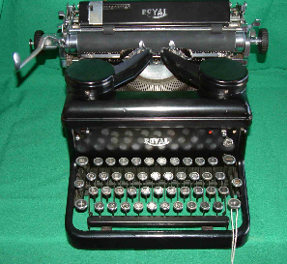
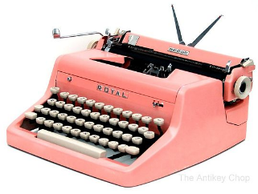
ROYAL TYPEWRITERS
The Royal Typewriter Company was a manufacturer of typewriters headquartered in New York City with its factory in Hartford, Connecticut
The Royal Typewriter Company was founded in January 1904 in a machine shop in Brooklyn, New York, by Edward B. Hess and Lewis C. Myers
In 1905, with their limited cash running out, Hess and Myers turned to Thomas Fortune Ryan, the wealthy financier

Slide 7
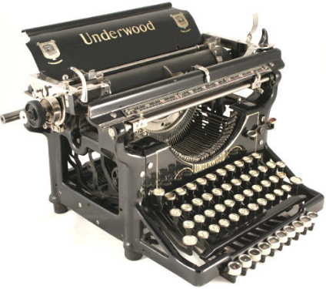
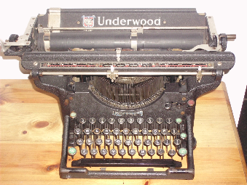
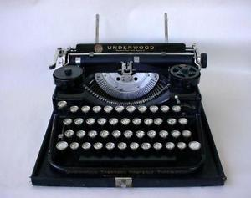
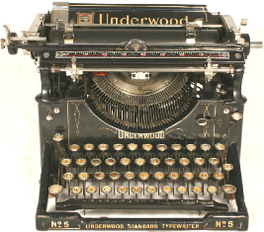
UNDERWOOD TYPEWRITERS
The Underwood Typewriter Company was a manufacturer of typewriters headquartered in New York City, New York
Underwood produced what is considered the first widely successful, modern typewriter
By 1939, Underwood had produced five million machines

Slide 8
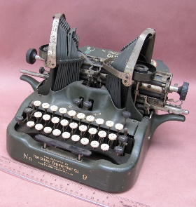
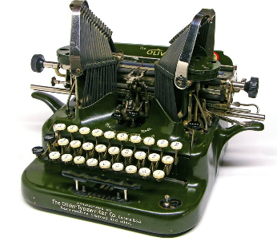
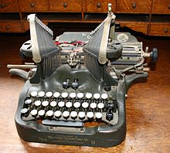
OLIVER TYPEWRITERS
The Oliver Typewriter Company was an American typewriter manufacturer headquartered in Chicago, Illinois
The last Oliver typewriter was produced in 1959.
Competitive pressure and financial troubles resulted in the company's liquidation in 1928.

Slide 9
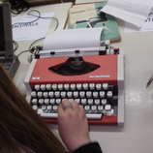
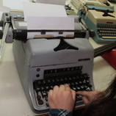
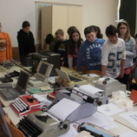
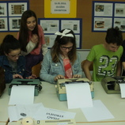
IMAGES FROM THE EXHIBITION IN OUR SCHOOL

Slide 10
INTERNET SOURCES
https://en.wikipedia.org/wiki/Olivetti
http://www.olivetti.com/
http://www.ebay.com/bhp/antique-typewriter
https://en.wikipedia.org/wiki/Smith_Corona
https://en.wikipedia.org/wiki/Royal_Typewriter_Company
https://en.wikipedia.org/wiki/Typewriter

Slide 11
THANK YOU
FOR
ATTENTION!
Vanesa Bubek, 6th grade
II. osnovna škola Čakovec
Croatia
Teacher Iva Naranđa

