Slide 1
Vacuum cleaner

Slide 2
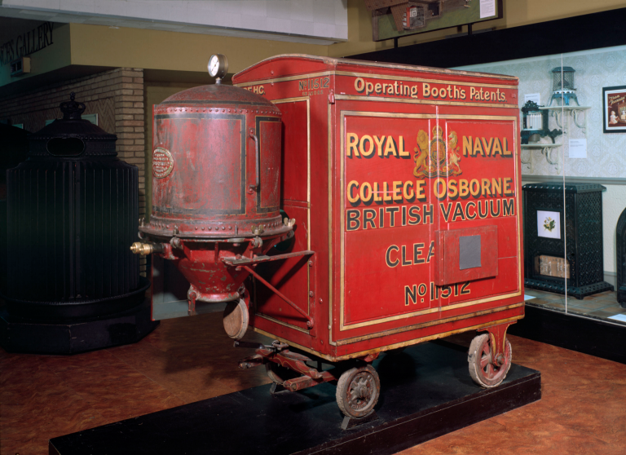
The motorized vacuum cleaner was invented by Hubert Cecil Booth of England in 1901.

Slide 3
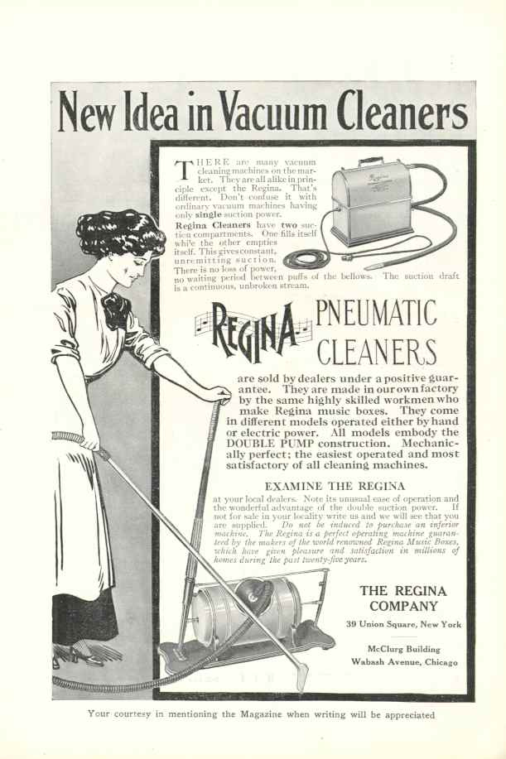
The first vacuum-cleaning device to be portable and marketed at the domestic market was built in 1905 by Walter Griffiths, a manufacturer in Birmingham, England.

Slide 4
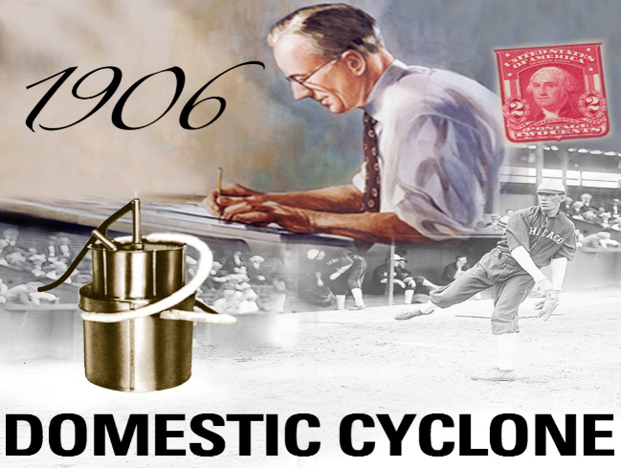
In 1906 James B. Kirby developed his first of many vacuums called the „Domestic Cyclone”. It used water for dirt separation.

Slide 5
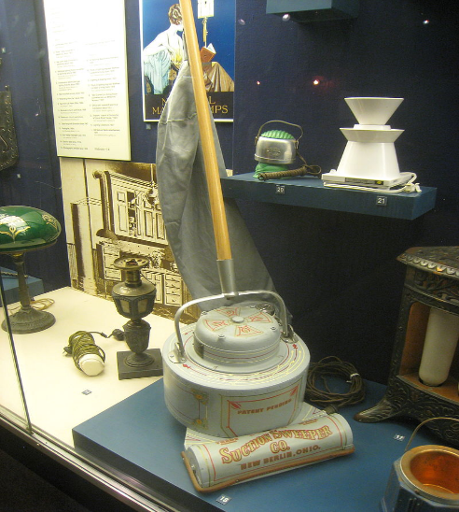
Early electric vacuum cleaner by Electric Suction Sweeper Company, circa 1908.

Slide 6
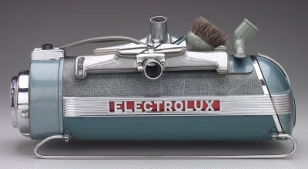
This innovation, conceived by Electrolux founder Axel Wenner-Gren, became a standard feature on generations of future vacuum cleaners. There is a recorded example of a 1930s Electrolux vacuum cleaner surviving in use for over 70 years, finally breaking in 2008.

Slide 7
In 2004 a British company released Airider, a hovering vacuum cleaner that floats on a cushion of air.

Slide 8
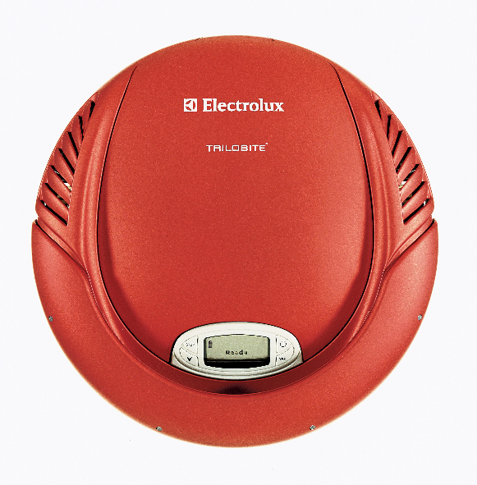
In 1997 Electrolux of Sweden demonstrated the Electrolux Trilobite.

Slide 9
By: Izidor Bistrović
6th grade
II. osnovna škola Čakovec, Croatia
June 2016
Teacher: Iva Naranđa
eTwinning project On the Track of Our Recent Past
Sources:
https://en.wikipedia.org/wiki/Vacuum_cleaner
https://en.wikipedia.org/wiki/Hubert_Cecil_Booth
http://www.wikiwand.com/en/Vacuum_cleaner

