Slide 1
EUROPE DAY

Slide 2
Europe is one of the world's seven continents. Comprising the westernmost peninsula of Eurasia, Europe is generally divided from Asia by the watershed divides of the Ural and Caucasus Mountains, the Ural River, the Caspian and Black Seas, and the waterways connecting the Black and Aegean Seas.

Slide 3
In ancient Greek mythology, Europa was a Phoenician princess whom Zeus abducted after assuming the form of a dazzling white bull. He took her to the island of Crete where she gave birth to Minos, Rhadamanthus, and Sarpedon. For Homer, Europe was a mythological queen of Crete, not a geographical designation.

Slide 4
The European Union (EU) is an economic and political union of 27 member states that are located primarily in Europe. The EU operates through a system of supranational independent institutions and intergovernmental negotiated decisions by the member states. Institutions of the EU include the European Commission, the Council of the European Union, the European Council, the Court of Justice of the European Union, the European Central Bank, the Court of Auditors, and the European Parliament. The European Parliament is elected every five years by EU citizens.

Slide 5
The flag of the European Union

Slide 6
In Europe, Europe Day is an annual celebration of peace and unity in Europe. There are two separate designations of Europe Day: 5 May for the Council of Europe, and 9 May for the European Union (EU). For the EU, the day is also known as Schuman Day, commemorating the historical declaration by French foreign minister Robert Schuman.

Slide 7
Robert Schuman (29 June 1886 – 4 September 1963) was a noted Luxembourgish-born German-French statesman. Schuman was a Christian Democrat (M.R.P.) and an independent political thinker and activist. Twice Prime Minister of France, a reformist Minister of Finance and a Foreign Minister, he was instrumental in building post-war European and trans-Atlantic institutions and is regarded as one of the founders of the European Union, the Council of Europe and NATO. The 1964–1965 academic year at the College of Europe was named in his honor.

Slide 8
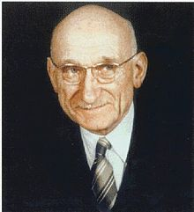
Robert Schuman’s photo

Slide 9
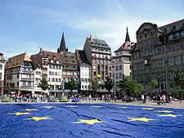
Happy Europe Day!!!

